Slide 1
Analysis Results from Folder - B3_B05_17.46_20.05

Slide 2
Analysis Results:
Metric | Value
Total time taken for the ride | 0 days 02:18:39.757000
Actual Ampere-hours (Ah) | 33.665416388888886
Actual Watt-hours (Wh) | 1739.5021568341665
Starting SoC (Ah) | 39.6
Ending SoC (Ah) | 5.579
Starting SoC (%) | 14.0
Ending SoC (%) | 99.0
Total distance covered (in kilometers) | 60.66392335791602
WH/KM | 28.6744091141474
Total SOC consumed | 85.0
Mode | Eco mode 50.43% Sports mode 41.24% Custom mode 3.00%
Peak Power | 6033.005824
Average Power | -755.6664371428743

Slide 3
Analysis Results:
Metric | Value
Total Energy Regenerated | 95.97401529333334
Regenerative Effectiveness | -5.228834716066615
Lowest Cell Voltage | 3.107
Highest Cell Voltage | 3.34
Difference in Cell Voltage | 0.23299999999999965
Minimum Temperature | 31.0
Maximum Temperature | 38.0
Difference in Temperature | nan
Maximum Fet Temperature | 47.0
Maximum Afe Temperature | 47.0
Maximum PCB Temperature | 45.0
Maximum MCU Temperature | 46.0
Maximum Motor Temperature | 0.0

Slide 4
Analysis Results:
Metric | Value
Abnormal Motor Temperature Detected | False
lowest cell temp | 42.0
highest cell temp | 31.0
Difference between Highest and Lowest Cell Temperature at 100% SOC | 11.0
Maximum BMS Temperature in C | 47.0
Battery Voltage | 5.5
Total energy charged in kWh | 0.18515979013888886
Electricity consumption units in kW | 6.182627123281673e-09
Idling time percentage | 9.407679307066651
Time spent in 0-10 km/h | 18.48262385127284
Time spent in 10-20 km/h | 10.39664096334636
Time spent in 20-30 km/h | 21.852223513256575
Time spent in 30-40 km/h | 41.86648357452202

Slide 5
Analysis Results:
Metric | Value
Time spent in 40-50 km/h | 7.069293334741735
Time spent in 50-60 km/h | 0.05809654589627126
Time spent in 60-70 km/h | 0.025087144818844404

Slide 6
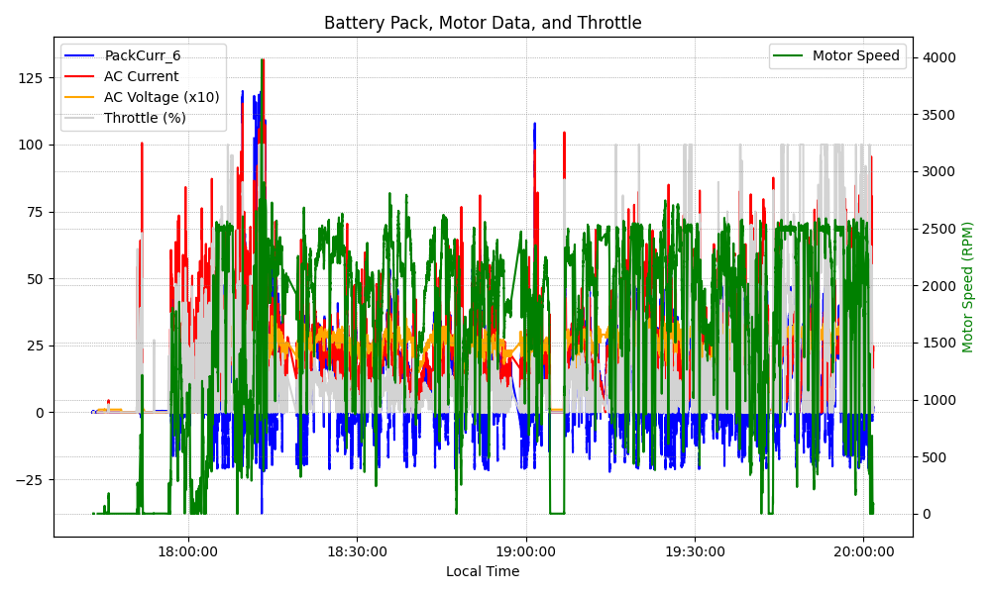
Graph Analysis

