Slide 1
Analysis Results from Folder - B3_B15_15.33_16.39

Slide 2
Analysis Results:
Metric | Value
Total time taken for the ride | 0 days 01:04:50.725000
Actual Ampere-hours (Ah) | 23.295388888888887
Actual Watt-hours (Wh) | 1202.0196433216668
Starting SoC (Ah) | 38.411
Ending SoC (Ah) | 14.015
Starting SoC (%) | 35.0
Ending SoC (%) | 96.0
Total distance covered (in kilometers) | 36.62457311111898
WH/KM | 32.82003150384138
Total SOC consumed | 61.0
Mode | Eco mode 64.47% Custom mode 30.64% Sports mode 0.08%
Peak Power | 5854.507213
Average Power | -1118.7359658629782

Slide 3
Analysis Results:
Metric | Value
Total Energy Regenerated | 53.572015515833336
Regenerative Effectiveness | -4.266675008452464
Lowest Cell Voltage | 3.082
Highest Cell Voltage | 3.33
Difference in Cell Voltage | 0.24800000000000022
Minimum Temperature | 34.0
Maximum Temperature | 41.0
Difference in Temperature | nan
Maximum Fet Temperature | 65.0
Maximum Afe Temperature | 61.0
Maximum PCB Temperature | 60.0
Maximum MCU Temperature | 48.0
Maximum Motor Temperature | 0.0

Slide 4
Analysis Results:
Metric | Value
Abnormal Motor Temperature Detected | False
lowest cell temp | 41.0
highest cell temp | 29.0
Difference between Highest and Lowest Cell Temperature at 100% SOC | 12.0
Maximum BMS Temperature in C | 65.0
Battery Voltage | 5.5
Total energy charged in kWh | 0.1281246388888889
Electricity consumption units in kW | 9.14914587895522e-09
Idling time percentage | 5.7068421774304126
Time spent in 0-10 km/h | 18.1406828465652
Time spent in 10-20 km/h | 3.5952283011106543
Time spent in 20-30 km/h | 7.072535307829425
Time spent in 30-40 km/h | 33.24283559577677

Slide 5
Analysis Results:
Metric | Value
Time spent in 40-50 km/h | 23.754284930755517
Time spent in 50-60 km/h | 13.475935828877006
Time spent in 60-70 km/h | 0.4662004662004662

Slide 6
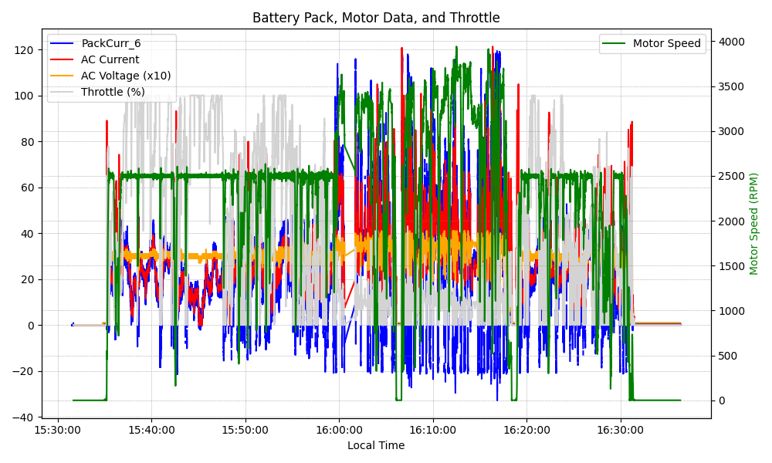
Graph Analysis

