Slide 1
Analysis Results from Folder - B3_B03_10.20_11.29

Slide 2
Analysis Results:
Metric | Value
Total time taken for the ride | 0 days 01:09:11.809000
Actual Ampere-hours (Ah) | 34.70677833333333
Actual Watt-hours (Wh) | 1763.1729981775002
Starting SoC (Ah) | 3.652
Ending SoC (Ah) | 4.698
Starting SoC (%) | 9.0
Ending SoC (%) | 99.0
Total distance covered (in kilometers) | 41.84414046820817
WH/KM | 42.13667620959026
Total SOC consumed | 2.0
Mode | Custom mode 69.09% Eco mode 26.05% Sports mode 0.17%
Peak Power | 6126.446865
Average Power | -1535.7906589496736

Slide 3
Analysis Results:
Metric | Value
Total Energy Regenerated | 108.28559662111111
Regenerative Effectiveness | -5.786160427063244
Lowest Cell Voltage | 2.93
Highest Cell Voltage | 3.379
Difference in Cell Voltage | 0.44899999999999984
Minimum Temperature | 28.0
Maximum Temperature | 46.0
Difference in Temperature | nan
Maximum Fet Temperature | 72.0
Maximum Afe Temperature | 70.0
Maximum PCB Temperature | 65.0
Maximum MCU Temperature | 49.0
Maximum Motor Temperature | 0.0

Slide 4
Analysis Results:
Metric | Value
Abnormal Motor Temperature Detected | False
lowest cell temp | 46.0
highest cell temp | 26.0
Difference between Highest and Lowest Cell Temperature at 100% SOC | 20.0
Maximum BMS Temperature in C | 72.0
Battery Voltage | 5.5
Total energy charged in kWh | 0.19088728083333334
Electricity consumption units in kW | 1.2773848392176807e-08
Idling time percentage | 6.0492546002176715
Time spent in 0-10 km/h | 16.23933787238351
Time spent in 10-20 km/h | 5.062137740767926
Time spent in 20-30 km/h | 9.172593586271482
Time spent in 30-40 km/h | 23.301020020754766

Slide 5
Analysis Results:
Metric | Value
Time spent in 40-50 km/h | 18.621073679414817
Time spent in 50-60 km/h | 17.436533448075124
Time spent in 60-70 km/h | 9.149813966438026

Slide 6
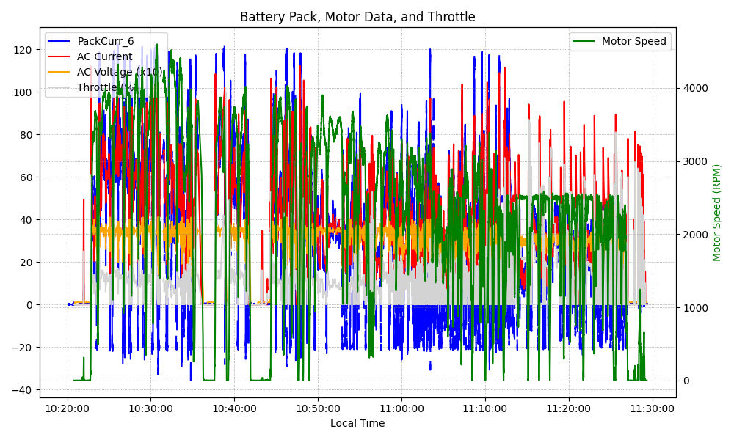
Graph Analysis

