Slide 1
Analysis Results from Folder - B3_B05_13.32_15.25

Slide 2
Analysis Results:
Metric | Value
Total time taken for the ride | 0 days 01:54:21.304000
Actual Ampere-hours (Ah) | 35.43623027777778
Actual Watt-hours (Wh) | 1823.8415698811111
Starting SoC (Ah) | 4.135
Ending SoC (Ah) | 4.423
Starting SoC (%) | 10.0
Ending SoC (%) | 99.0
Total distance covered (in kilometers) | 56.7960429328498
WH/KM | 32.11212393858929
Total SOC consumed | 1.0
Mode | Eco mode 97.11% Custom mode 1.97% Sports mode 0.83%
Peak Power | 6129.537488
Average Power | -961.6036396561219

Slide 3
Analysis Results:
Metric | Value
Total Energy Regenerated | 134.23320898916666
Regenerative Effectiveness | -6.855366834693272
Lowest Cell Voltage | 3.106
Highest Cell Voltage | 3.376
Difference in Cell Voltage | 0.27
Minimum Temperature | 32.0
Maximum Temperature | 42.0
Difference in Temperature | nan
Maximum Fet Temperature | 58.0
Maximum Afe Temperature | 52.0
Maximum PCB Temperature | 51.0
Maximum MCU Temperature | 48.0
Maximum Motor Temperature | 0.0

Slide 4
Analysis Results:
Metric | Value
Abnormal Motor Temperature Detected | False
lowest cell temp | 42.0
highest cell temp | 32.0
Difference between Highest and Lowest Cell Temperature at 100% SOC | 10.0
Maximum BMS Temperature in C | 58.0
Battery Voltage | 5.5
Total energy charged in kWh | 0.1948992665277778
Electricity consumption units in kW | 7.890786349891408e-09
Idling time percentage | 5.0872550872550875
Time spent in 0-10 km/h | 15.376740376740377
Time spent in 10-20 km/h | 7.411957411957412
Time spent in 20-30 km/h | 11.477036477036478
Time spent in 30-40 km/h | 44.885969885969885

Slide 5
Analysis Results:
Metric | Value
Time spent in 40-50 km/h | 19.802494802494802
Time spent in 50-60 km/h | 0.24885024885024887
Time spent in 60-70 km/h | 0.3858753858753859

Slide 6
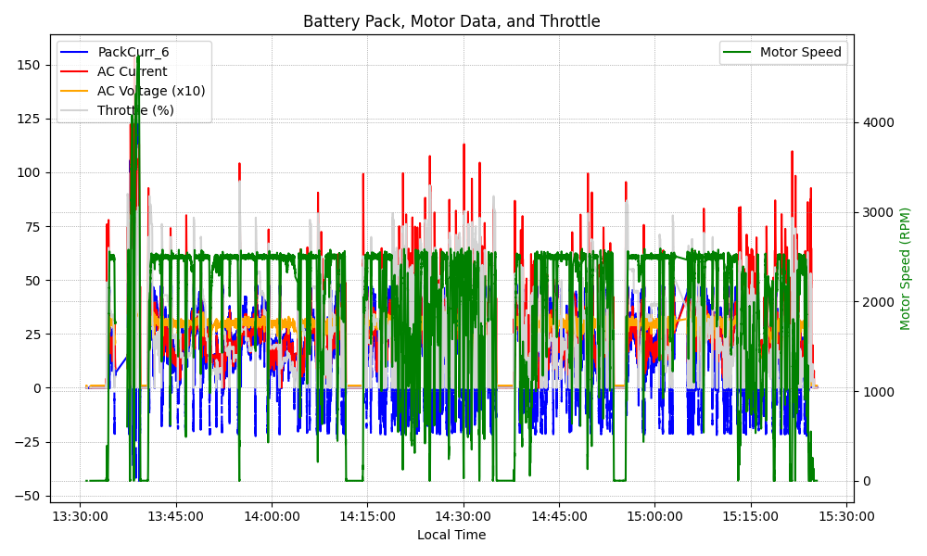
Graph Analysis

