Slide 1
Analysis Results from Folder - B3_B15_11.35_13.28

Slide 2
Analysis Results:
Metric | Value
Total time taken for the ride | 0 days 01:54:30.161000
Actual Ampere-hours (Ah) | 33.27927277777778
Actual Watt-hours (Wh) | 1717.139885148611
Starting SoC (Ah) | 4.697
Ending SoC (Ah) | 4.135
Starting SoC (%) | 10.0
Ending SoC (%) | 100.0
Total distance covered (in kilometers) | 56.04125756068157
WH/KM | 30.64063798513602
Total SOC consumed | 1.0
Mode | Eco mode 99.75% Sports mode 0.04% Custom mode 0.04%
Peak Power | 2471.347216
Average Power | -904.6836801602516

Slide 3
Analysis Results:
Metric | Value
Total Energy Regenerated | 79.19017365777778
Regenerative Effectiveness | -4.408442272039773
Lowest Cell Voltage | 3.125
Highest Cell Voltage | 3.382
Difference in Cell Voltage | 0.2570000000000001
Minimum Temperature | 28.0
Maximum Temperature | 46.0
Difference in Temperature | nan
Maximum Fet Temperature | 57.0
Maximum Afe Temperature | 61.0
Maximum PCB Temperature | 59.0
Maximum MCU Temperature | 45.0
Maximum Motor Temperature | 0.0

Slide 4
Analysis Results:
Metric | Value
Abnormal Motor Temperature Detected | False
lowest cell temp | 46.0
highest cell temp | 28.0
Difference between Highest and Lowest Cell Temperature at 100% SOC | 18.0
Maximum BMS Temperature in C | 57.0
Battery Voltage | 5.5
Total energy charged in kWh | 0.18303600027777775
Electricity consumption units in kW | 7.400776333405214e-09
Idling time percentage | 2.2019386106623586
Time spent in 0-10 km/h | 20.379644588045235
Time spent in 10-20 km/h | 3.652665589660743
Time spent in 20-30 km/h | 7.857835218093699
Time spent in 30-40 km/h | 45.88368336025848

Slide 5
Analysis Results:
Metric | Value
Time spent in 40-50 km/h | 21.704361873990308
Time spent in 50-60 km/h | 0.0
Time spent in 60-70 km/h | 0.0

Slide 6
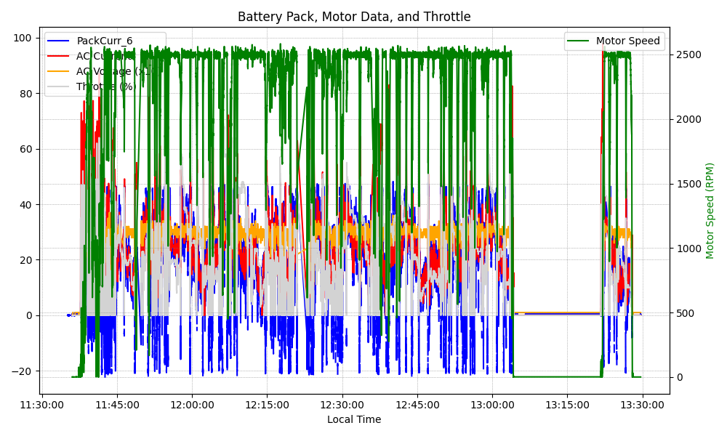
Graph Analysis

