Slide 1
Analysis Results from Folder - B3_B15_19.35_20.40

Slide 2
Analysis Results:
Metric | Value
Total time taken for the ride | 0 days 01:04:57.056000
Actual Ampere-hours (Ah) | 27.0011225
Actual Watt-hours (Wh) | 1384.736395011389
Starting SoC (Ah) | 39.556
Ending SoC (Ah) | 10.745
Starting SoC (%) | 27.0
Ending SoC (%) | 99.0
Total distance covered (in kilometers) | 40.596084622018495
WH/KM | 34.110097264412936
Total SOC consumed | 72.0
Mode | Custom mode 85.39% Sports mode 9.95% Eco mode 2.11%
Peak Power | 6239.258608
Average Power | -1290.7951895497154

Slide 3
Analysis Results:
Metric | Value
Total Energy Regenerated | 104.66714305805554
Regenerative Effectiveness | -7.027453633803263
Lowest Cell Voltage | 3.077
Highest Cell Voltage | 3.466
Difference in Cell Voltage | 0.38900000000000023
Minimum Temperature | 35.0
Maximum Temperature | 47.0
Difference in Temperature | nan
Maximum Fet Temperature | 71.0
Maximum Afe Temperature | 67.0
Maximum PCB Temperature | 67.0
Maximum MCU Temperature | 47.0
Maximum Motor Temperature | 0.0

Slide 4
Analysis Results:
Metric | Value
Abnormal Motor Temperature Detected | False
lowest cell temp | 47.0
highest cell temp | 35.0
Difference between Highest and Lowest Cell Temperature at 100% SOC | 12.0
Maximum BMS Temperature in C | 71.0
Battery Voltage | 5.6
Total energy charged in kWh | 0.151206286
Electricity consumption units in kW | 1.0777969235594332e-08
Idling time percentage | 3.939944534761404
Time spent in 0-10 km/h | 12.052532593796819
Time spent in 10-20 km/h | 8.402664881578529
Time spent in 20-30 km/h | 12.074846195530904
Time spent in 30-40 km/h | 17.363169806509195

Slide 5
Analysis Results:
Metric | Value
Time spent in 40-50 km/h | 17.885945618564918
Time spent in 50-60 km/h | 23.99349717892321
Time spent in 60-70 km/h | 7.602562876542029

Slide 6
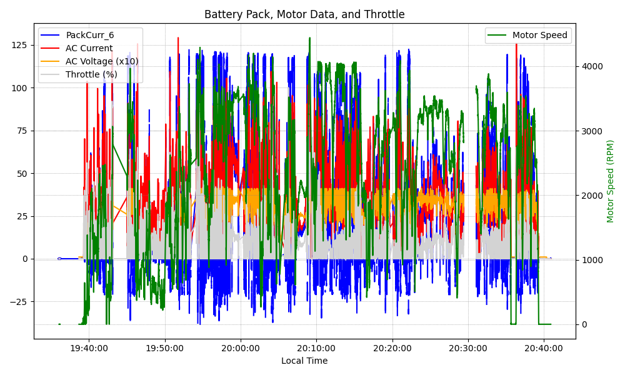
Graph Analysis

