Slide 1
Analysis Results from Folder - MAR_21

Slide 2
Analysis Results:
Metric | Value
Total time taken for the ride | 0 days 00:04:55.880000
Actual Ampere-hours (Ah) | -0.496635
Actual Watt-hours (Wh) | -25.81896295027778
Starting SoC (Ah) | 33.91
Ending SoC (Ah) | 34.433
Total distance covered (in kilometers) | 3.4955890920449577
WH/KM | -40.360253303742816
Total SOC consumed | 1.0%
Mode | Eco mode

Slide 3
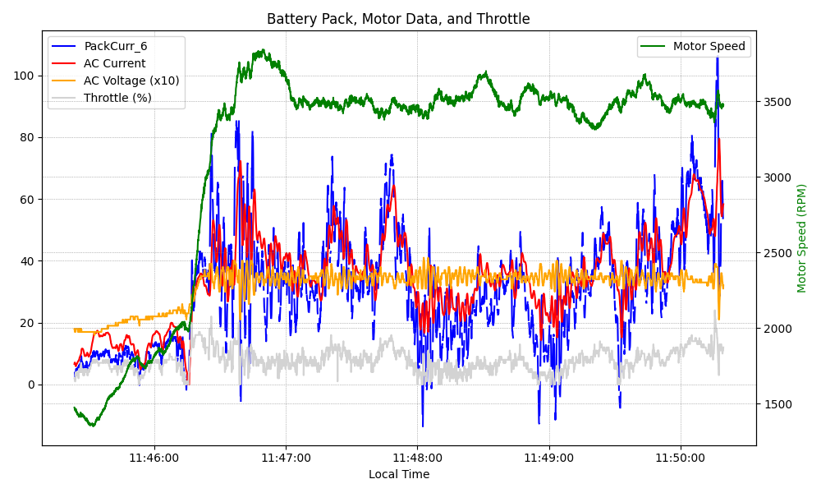
Graph Analysis

