Slide 1
Analysis Results from Folder - B3_B15_19.35_20.40

Slide 2
Analysis Results:
Metric | Value
Date and Time | 2024-03-12 19:35:27.687000 to 2024-03-12 20:40:53.242000
Total time taken for the ride | 0 days 01:04:57.056000
Actual Ampere-hours (Ah) | 27.0011225
Actual Watt-hours (Wh) | 1384.736395011389
Starting SoC (Ah) | 39.556
Ending SoC (Ah) | 10.745
Starting SoC (%) | 99.0
Ending SoC (%) | 27.0
Total distance covered (km) | 40.596084622018495
Total energy consumption(WH/KM) | 34.110097264412936
Total SOC consumed(%) | 72.0
Mode | Custom mode 85.39% Sports mode 9.95% Eco mode 2.11%
Peak Power(kW) | 6239.258608

Slide 3
Analysis Results:
Metric | Value
Average Power(kW) | -1290.7951895497154
Total Energy Regenerated(kWh) | 104.66714305805554
Regenerative Effectiveness(%) | 7.027453633803263
Highest Cell Voltage(V) | 3.466
Lowest Cell Voltage(V) | 3.077
Difference in Cell Voltage(V) | 0.38900000000000023
Minimum Temperature(C) | 35.0
Maximum Temperature(C) | 47.0
Difference in Temperature(C) | 12.0
Maximum Fet Temperature-BMS(C) | 71.0
Maximum Afe Temperature-BMS(C) | 67.0
Maximum PCB Temperature-BMS(C) | 67.0
Maximum MCU Temperature(C) | 47.0

Slide 4
Analysis Results:
Metric | Value
Maximum Motor Temperature(C) | 0.0
Abnormal Motor Temperature Detected(C) | False
highest cell temp(C) | 47.0
lowest cell temp(C) | 35.0
Difference between Highest and Lowest Cell Temperature at 100% SOC(C) | 12.0
Battery Voltage(V) | 56.0
Total energy charged(kWh) | 1.51206286
Electricity consumption units(kW) | 1.077796923559433e-07
Cycle Count of battery | 116.0
Idling time percentage | 4.500972235504128
Time spent in 0-10 km/h | 8.112588059035415
Time spent in 10-20 km/h | 8.380351279844442
Time spent in 20-30 km/h | 12.065283223359154

Slide 5
Analysis Results:
Metric | Value
Time spent in 30-40 km/h | 17.337668547384528
Time spent in 40-50 km/h | 17.84769372987791
Time spent in 50-60 km/h | 23.936119345892703
Time spent in 60-70 km/h | 7.586624589589111
Time spent in 70-80 km/h | 0.0637531478116732
Time spent in 80-90 km/h | 0.0

Slide 6
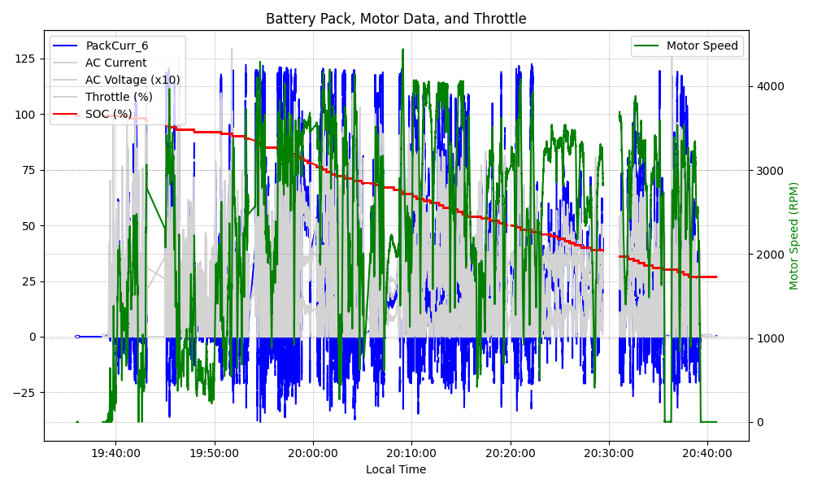
Graph Analysis

