Slide 1
Analysis Results from Folder - B3_B03_10.20_11.29

Slide 2
Analysis Results:
Metric | Value
Date and Time | 2024-03-12 10:20:08.465000 to 2024-03-12 11:29:19.295000
Total time taken for the ride | 0 days 01:09:11.809000
Actual Ampere-hours (Ah) | 34.70677833333333
Actual Watt-hours (Wh) | 1763.1729981775002
Starting SoC (Ah) | 3.652
Ending SoC (Ah) | 4.698
Starting SoC (%) | 99.0
Ending SoC (%) | 9.0
Total distance covered (km) | 41.84414046820817
Total energy consumption(WH/KM) | 42.13667620959026
Total SOC consumed(%) | 90.0
Mode | Custom mode 69.09% Eco mode 26.05% Sports mode 0.17%
Peak Power(kW) | 6126.446865

Slide 3
Analysis Results:
Metric | Value
Average Power(kW) | -1535.7906589496736
Total Energy Regenerated(kWh) | 108.28559662111111
Regenerative Effectiveness(%) | 5.786160427063244
Highest Cell Voltage(V) | 3.379
Lowest Cell Voltage(V) | 2.93
Difference in Cell Voltage(V) | 0.44899999999999984
Minimum Temperature(C) | 28.0
Maximum Temperature(C) | 46.0
Difference in Temperature(C) | 18.0
Maximum Fet Temperature-BMS(C) | 72.0
Maximum Afe Temperature-BMS(C) | 70.0
Maximum PCB Temperature-BMS(C) | 65.0
Maximum MCU Temperature(C) | 49.0

Slide 4
Analysis Results:
Metric | Value
Maximum Motor Temperature(C) | 0.0
Abnormal Motor Temperature Detected(C) | False
highest cell temp(C) | 46.0
lowest cell temp(C) | 26.0
Difference between Highest and Lowest Cell Temperature at 100% SOC(C) | 20.0
Battery Voltage(V) | 55.0
Total energy charged(kWh) | 1.9088728083333333
Electricity consumption units(kW) | 1.2773848392176807e-07
Cycle Count of battery | 137.0
Idling time percentage | 6.664304335720975
Time spent in 0-10 km/h | 10.190083272165836
Time spent in 10-20 km/h | 5.044420258675238
Time spent in 20-30 km/h | 9.16500037966033

Slide 5
Analysis Results:
Metric | Value
Time spent in 30-40 km/h | 23.288364676402846
Time spent in 40-50 km/h | 18.383153205598724
Time spent in 50-60 km/h | 17.406160621630516
Time spent in 60-70 km/h | 9.127034346604571
Time spent in 70-80 km/h | 0.3999088815206662
Time spent in 80-90 km/h | 0.0

Slide 6
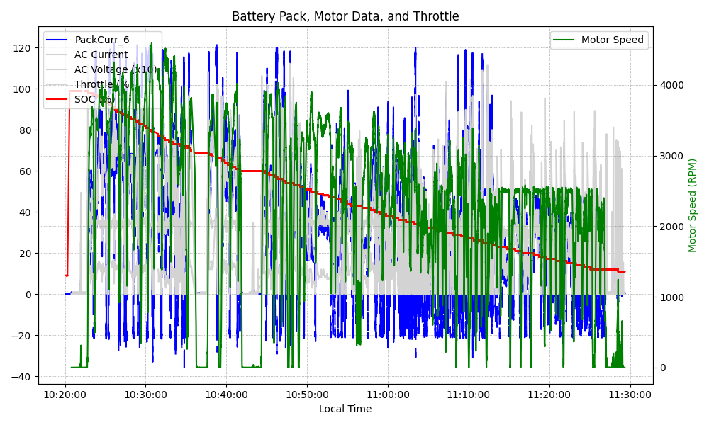
Graph Analysis

