Slide 1
Analysis Results from Folder - B3_B03_13.15_15.30

Slide 2
Analysis Results:
Metric | Value
Date and Time | 2024-03-11 13:17:50.432000 to 2024-03-11 15:29:55.824000
Total time taken for the ride | 0 days 02:16:27.789000
Actual Ampere-hours (Ah) | 35.83509361111111
Actual Watt-hours (Wh) | 1842.9312340324998
Starting SoC (Ah) | 38.646
Ending SoC (Ah) | 3.126
Starting SoC (%) | 97.0
Ending SoC (%) | 0.0
Total distance covered (km) | 69.78145244294669
Total energy consumption(WH/KM) | 26.410044066355315
Total SOC consumed(%) | 97.0
Mode | Eco mode 98.43%
Peak Power(kW) | 2438.510646

Slide 3
Analysis Results:
Metric | Value
Average Power(kW) | -813.6561739657836
Total Energy Regenerated(kWh) | 22.40473596861111
Regenerative Effectiveness(%) | 1.2011099517154418
Highest Cell Voltage(V) | 3.339
Lowest Cell Voltage(V) | 2.985
Difference in Cell Voltage(V) | 0.3540000000000001
Minimum Temperature(C) | 23.0
Maximum Temperature(C) | 44.0
Difference in Temperature(C) | 21.0
Maximum Fet Temperature-BMS(C) | 58.0
Maximum Afe Temperature-BMS(C) | 62.0
Maximum PCB Temperature-BMS(C) | 57.0
Maximum MCU Temperature(C) | 42.0

Slide 4
Analysis Results:
Metric | Value
Maximum Motor Temperature(C) | 0.0
Abnormal Motor Temperature Detected(C) | False
highest cell temp(C) | 44.0
lowest cell temp(C) | 0.0
Difference between Highest and Lowest Cell Temperature at 100% SOC(C) | 44.0
Battery Voltage(V) | 55.0
Total energy charged(kWh) | 1.9709301486111113
Electricity consumption units(kW) | 6.687194293836812e-08
Cycle Count of battery | 75.0
Idling time percentage | 18.293057153816648
Time spent in 0-10 km/h | 4.760260836210203
Time spent in 10-20 km/h | 1.6634701444828026
Time spent in 20-30 km/h | 3.11724843370413

Slide 5
Analysis Results:
Metric | Value
Time spent in 30-40 km/h | 41.70950006393044
Time spent in 40-50 km/h | 28.172867919703364
Time spent in 50-60 km/h | 0.0
Time spent in 60-70 km/h | 0.0
Time spent in 70-80 km/h | 0.0
Time spent in 80-90 km/h | 0.0

Slide 6
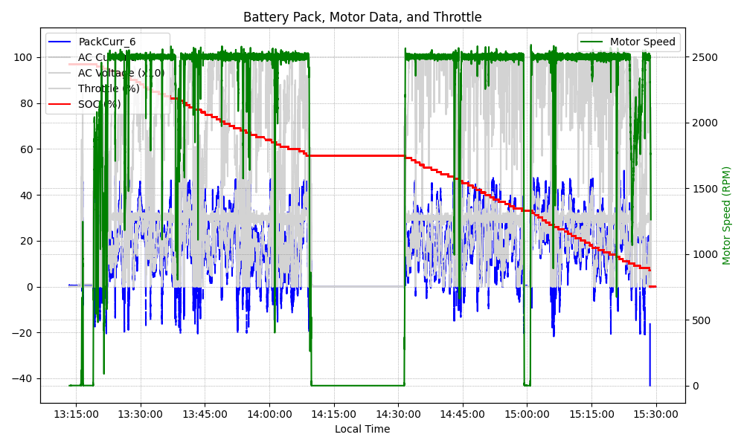
Graph Analysis

