Slide 1
Analysis Results from Folder - B3_B03_15.25_17.37

Slide 2
Analysis Results:
Metric | Value
Date and Time | 2024-03-12 15:26:19.887000 to 2024-03-12 17:37:35.929000
Total time taken for the ride | 0 days 02:11:22.382000
Actual Ampere-hours (Ah) | 33.47750777777778
Actual Watt-hours (Wh) | 1736.0360734966666
Starting SoC (Ah) | 37.326
Ending SoC (Ah) | 5.944
Starting SoC (%) | 100.0
Ending SoC (%) | 15.0
Total distance covered (km) | 70.59788385330441
Total energy consumption(WH/KM) | 24.59048315249763
Total SOC consumed(%) | 85.0
Mode | Eco mode 77.10% Sports mode 18.20% Custom mode 0.05%
Peak Power(kW) | 5317.71037

Slide 3
Analysis Results:
Metric | Value
Average Power(kW) | -799.4026432064467
Total Energy Regenerated(kWh) | 69.98707205138889
Regenerative Effectiveness(%) | 3.875203494701095
Highest Cell Voltage(V) | 3.522
Lowest Cell Voltage(V) | 3.05
Difference in Cell Voltage(V) | 0.472
Minimum Temperature(C) | 38.0
Maximum Temperature(C) | 48.0
Difference in Temperature(C) | 10.0
Maximum Fet Temperature-BMS(C) | 63.0
Maximum Afe Temperature-BMS(C) | 67.0
Maximum PCB Temperature-BMS(C) | 61.0
Maximum MCU Temperature(C) | 46.0

Slide 4
Analysis Results:
Metric | Value
Maximum Motor Temperature(C) | 0.0
Abnormal Motor Temperature Detected(C) | False
highest cell temp(C) | 48.0
lowest cell temp(C) | 38.0
Difference between Highest and Lowest Cell Temperature at 100% SOC(C) | 10.0
Battery Voltage(V) | 56.0
Total energy charged(kWh) | 1.8747404355555557
Electricity consumption units(kW) | 6.606968181917856e-08
Cycle Count of battery | 137.0
Idling time percentage | 4.9415367483296215
Time spent in 0-10 km/h | 7.743596881959911
Time spent in 10-20 km/h | 6.531180400890868
Time spent in 20-30 km/h | 8.083240534521158

Slide 5
Analysis Results:
Metric | Value
Time spent in 30-40 km/h | 48.46185968819599
Time spent in 40-50 km/h | 22.46380846325167
Time spent in 50-60 km/h | 0.0
Time spent in 60-70 km/h | 0.0
Time spent in 70-80 km/h | 0.0
Time spent in 80-90 km/h | 0.0

Slide 6
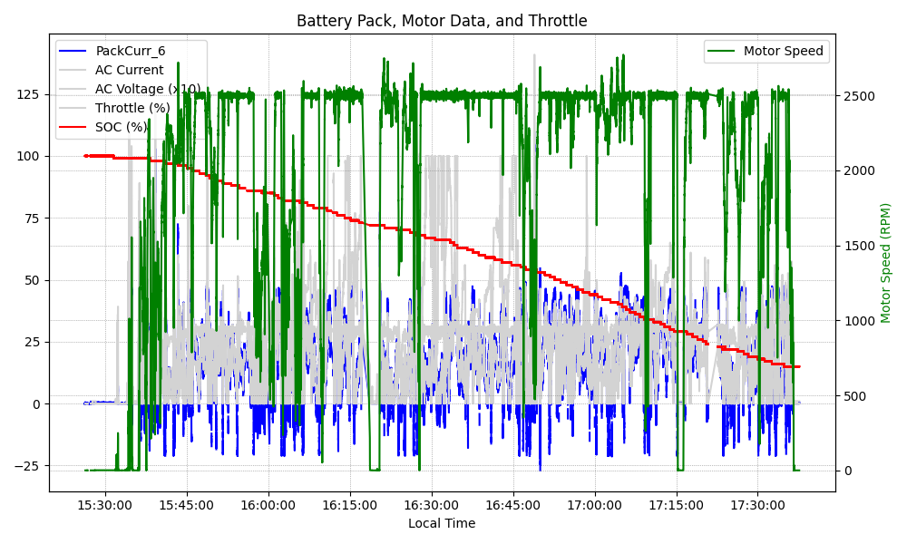
Graph Analysis

