Slide 1
Analysis Results from Folder - B3_B05_13.32_15.25

Slide 2
Analysis Results:
Metric | Value
Date and Time | 2024-03-12 13:31:02.656000 to 2024-03-12 15:25:21.109000
Total time taken for the ride | 0 days 01:54:21.304000
Actual Ampere-hours (Ah) | 35.43623027777778
Actual Watt-hours (Wh) | 1823.8415698811111
Starting SoC (Ah) | 4.135
Ending SoC (Ah) | 4.423
Starting SoC (%) | 99.0
Ending SoC (%) | 10.0
Total distance covered (km) | 56.7960429328498
Total energy consumption(WH/KM) | 32.11212393858929
Total SOC consumed(%) | 89.0
Mode | Eco mode 97.11% Custom mode 1.97% Sports mode 0.83%
Peak Power(kW) | 6129.537488

Slide 3
Analysis Results:
Metric | Value
Average Power(kW) | -961.6036396561219
Total Energy Regenerated(kWh) | 134.23320898916666
Regenerative Effectiveness(%) | 6.855366834693272
Highest Cell Voltage(V) | 3.376
Lowest Cell Voltage(V) | 3.106
Difference in Cell Voltage(V) | 0.27
Minimum Temperature(C) | 32.0
Maximum Temperature(C) | 42.0
Difference in Temperature(C) | 10.0
Maximum Fet Temperature-BMS(C) | 58.0
Maximum Afe Temperature-BMS(C) | 52.0
Maximum PCB Temperature-BMS(C) | 51.0
Maximum MCU Temperature(C) | 48.0

Slide 4
Analysis Results:
Metric | Value
Maximum Motor Temperature(C) | 0.0
Abnormal Motor Temperature Detected(C) | False
highest cell temp(C) | 42.0
lowest cell temp(C) | 32.0
Difference between Highest and Lowest Cell Temperature at 100% SOC(C) | 10.0
Battery Voltage(V) | 55.0
Total energy charged(kWh) | 1.948992665277778
Electricity consumption units(kW) | 7.890786349891408e-08
Cycle Count of battery | 115.0
Idling time percentage | 5.18963018963019
Time spent in 0-10 km/h | 10.28948528948529
Time spent in 10-20 km/h | 7.3977823977823975
Time spent in 20-30 km/h | 11.454986454986454

Slide 5
Analysis Results:
Metric | Value
Time spent in 30-40 km/h | 44.86549486549487
Time spent in 40-50 km/h | 18.42909342909343
Time spent in 50-60 km/h | 0.24885024885024887
Time spent in 60-70 km/h | 0.3858753858753859
Time spent in 70-80 km/h | 0.30870030870030873
Time spent in 80-90 km/h | 0.0

Slide 6
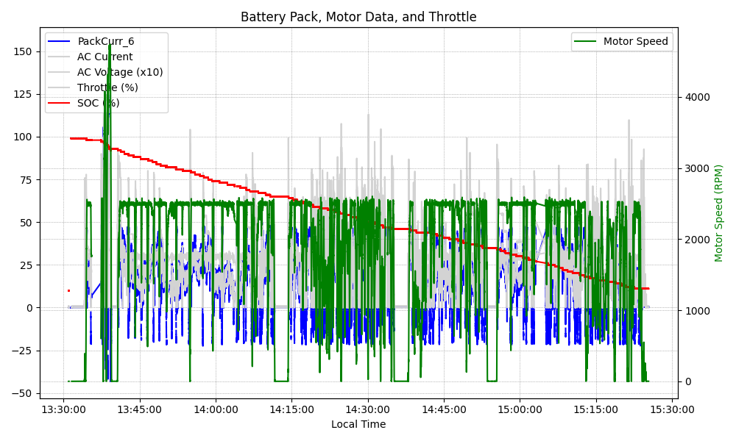
Graph Analysis

