Slide 1
Analysis Results from Folder - B4_BT06_17.05_17.45

Slide 2
Analysis Results:
Metric | Value
Date and Time | 2024-03-11 17:05:16.843000 to 2024-03-11 17:45:12.156000
Total time taken for the ride | 0 days 00:39:56.273000
Actual Ampere-hours (Ah) | 20.897132222222226
Actual Watt-hours (Wh) | 1058.0849816355556
Starting SoC (Ah) | 25.2
Ending SoC (Ah) | 3.427
Starting SoC (%) | 63.0
Ending SoC (%) | 8.0
Total distance covered (km) | 24.58373603844754
Total energy consumption(WH/KM) | 43.040039967105564
Total SOC consumed(%) | 55.0
Mode | Custom mode 56.98% Eco mode 43.02%
Peak Power(kW) | 5176.618119

Slide 3
Analysis Results:
Metric | Value
Average Power(kW) | -1595.1029873902849
Total Energy Regenerated(kWh) | 0.061052225
Regenerative Effectiveness(%) | 0.005769735277205185
Highest Cell Voltage(V) | 3.338
Lowest Cell Voltage(V) | 3.034
Difference in Cell Voltage(V) | 0.30400000000000027
Minimum Temperature(C) | 40.0
Maximum Temperature(C) | 47.0
Difference in Temperature(C) | 7.0
Maximum Fet Temperature-BMS(C) | 66.0
Maximum Afe Temperature-BMS(C) | 61.0
Maximum PCB Temperature-BMS(C) | 62.0
Maximum MCU Temperature(C) | 68.0

Slide 4
Analysis Results:
Metric | Value
Maximum Motor Temperature(C) | 98.0
Abnormal Motor Temperature Detected(C) | False
highest cell temp(C) | 47.0
lowest cell temp(C) | 40.0
Difference between Highest and Lowest Cell Temperature at 100% SOC(C) | 7.0
Battery Voltage(V) | 53.0
Total energy charged(kWh) | 1.107548007777778
Electricity consumption units(kW) | 1.2840243087759436e-07
Cycle Count of battery | 38.0
Idling time percentage | 1.3204389064534128
Time spent in 0-10 km/h | 4.863306676585457
Time spent in 10-20 km/h | 6.57429793565185
Time spent in 20-30 km/h | 12.665054863306677

Slide 5
Analysis Results:
Metric | Value
Time spent in 30-40 km/h | 51.91091686814209
Time spent in 40-50 km/h | 9.842849172400966
Time spent in 50-60 km/h | 7.355402640877813
Time spent in 60-70 km/h | 4.379765668588432
Time spent in 70-80 km/h | 0.9717314487632509
Time spent in 80-90 km/h | 0.0

Slide 6
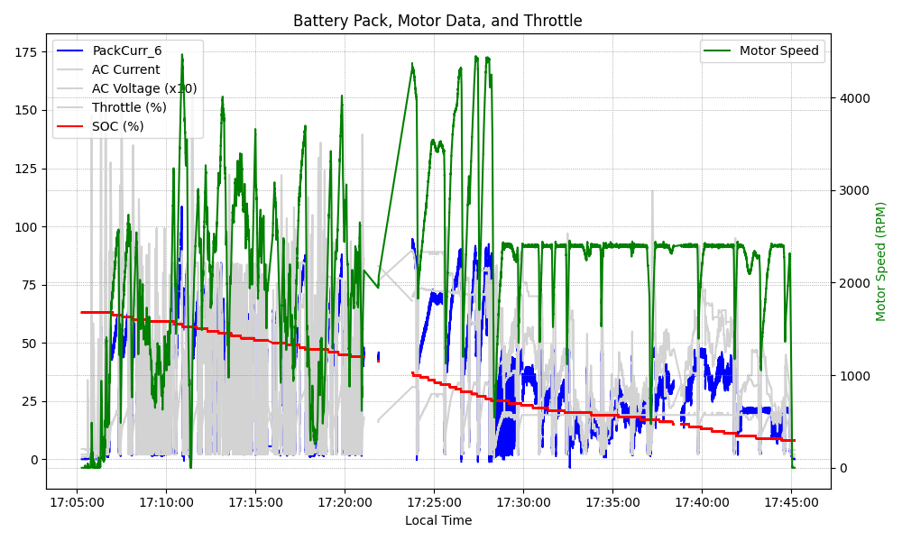
Graph Analysis

