Slide 1
Analysis Results from Folder - B4_BT02_09.56_10.40

Slide 2
Analysis Results:
Metric | Value
Total time taken for the ride | 0 days 00:44:32.861000
Actual Ampere-hours (Ah) | 29.757495277777775
Actual Watt-hours (Wh) | 1501.1567687794447
Starting SoC (Ah) | 38.875
Ending SoC (Ah) | 9.025
Starting SoC (%) | 98.0
Ending SoC (%) | 22.0
Total distance covered (km) | 30.62844142383255
Total energy consumption(WH/KM) | 49.011856268055716
Total SOC consumed(%) | 76.0
Mode | Custom mode 84.72% Eco mode 14.25% Sports mode 0.04%
Peak Power(kW) | 5427.163392
Average Power(kW) | -2028.5902280803307

Slide 3
Analysis Results:
Metric | Value
Total Energy Regenerated(kWh) | 0.012831445277777775
Regenerative Effectiveness(%) | 0.0008547631976997756
Highest Cell Voltage(V) | 3.329
Lowest Cell Voltage(V) | 3.017
Difference in Cell Voltage(V) | 0.3120000000000003
Minimum Temperature(C) | 26.0
Maximum Temperature(C) | 40.0
Difference in Temperature(C) | 14.0
Maximum Fet Temperature-BMS(C) | 62.0
Maximum Afe Temperature-BMS(C) | 60.0
Maximum PCB Temperature-BMS(C) | 57.0
Maximum MCU Temperature(C) | 66.0
Maximum Motor Temperature(C) | 102.0

Slide 4
Analysis Results:
Metric | Value
Abnormal Motor Temperature Detected(C) | False
highest cell temp(C) | 40.0
lowest cell temp(C) | 25.0
Difference between Highest and Lowest Cell Temperature at 100% SOC(C) | 15.0
Battery Voltage(V) | 53.0
Total energy charged(kWh) | 1.577147249722222
Electricity consumption units(kW) | 1.6395825533539401e-07
Idling time percentage | 7.848300255452938
Time spent in 0-10 km/h | 10.556101395166044
Time spent in 10-20 km/h | 5.380231872666536
Time spent in 20-30 km/h | 8.630379249361368
Time spent in 30-40 km/h | 13.29534289644331
Time spent in 40-50 km/h | 12.1988602868933

Slide 5
Analysis Results:
Metric | Value
Time spent in 50-60 km/h | 12.587934761249755
Time spent in 60-70 km/h | 19.68952642955394
Time spent in 70-80 km/h | 9.660051090587542
Time spent in 80-90 km/h | 0.0

Slide 6
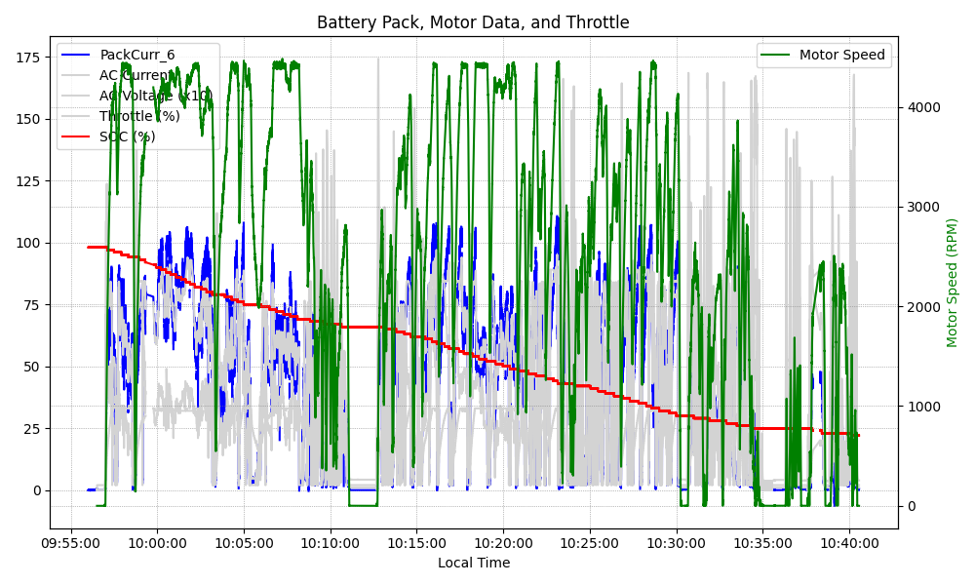
Graph Analysis

