Slide 1
Analysis Results from Folder - B4_BT02_13.59_14.50

Slide 2
Analysis Results:
Metric | Value
Total time taken for the ride | 0 days 00:50:22.552000
Actual Ampere-hours (Ah) | 33.50112111111111
Actual Watt-hours (Wh) | 1707.7808621605554
Starting SoC (Ah) | 39.51
Ending SoC (Ah) | 6.548
Starting SoC (%) | 99.0
Ending SoC (%) | 16.0
Total distance covered (km) | 32.755001923512395
Total energy consumption(WH/KM) | 52.138017459088154
Total SOC consumed(%) | 83.0
Mode | Custom mode 78.47% Eco mode 21.53%
Peak Power(kW) | 5428.3737
Average Power(kW) | -2041.1723452118194

Slide 3
Analysis Results:
Metric | Value
Total Energy Regenerated(kWh) | 0.06724817500000001
Regenerative Effectiveness(%) | 0.003937596943956988
Highest Cell Voltage(V) | 3.43
Lowest Cell Voltage(V) | 3.088
Difference in Cell Voltage(V) | 0.3420000000000001
Minimum Temperature(C) | 38.0
Maximum Temperature(C) | 47.0
Difference in Temperature(C) | 9.0
Maximum Fet Temperature-BMS(C) | 68.0
Maximum Afe Temperature-BMS(C) | 67.0
Maximum PCB Temperature-BMS(C) | 65.0
Maximum MCU Temperature(C) | 71.0
Maximum Motor Temperature(C) | 101.0

Slide 4
Analysis Results:
Metric | Value
Abnormal Motor Temperature Detected(C) | False
highest cell temp(C) | 47.0
lowest cell temp(C) | 38.0
Difference between Highest and Lowest Cell Temperature at 100% SOC(C) | 9.0
Battery Voltage(V) | 54.0
Total energy charged(kWh) | 1.80906054
Electricity consumption units(kW) | 1.6628617361570703e-07
Idling time percentage | 0.6348974677078012
Time spent in 0-10 km/h | 4.8493030723199295
Time spent in 10-20 km/h | 8.115011311391667
Time spent in 20-30 km/h | 16.069473837845727
Time spent in 30-40 km/h | 26.731372692111215
Time spent in 40-50 km/h | 12.5702400934102

Slide 5
Analysis Results:
Metric | Value
Time spent in 50-60 km/h | 13.055535284244327
Time spent in 60-70 km/h | 10.078085090856016
Time spent in 70-80 km/h | 7.724585857111581
Time spent in 80-90 km/h | 0.0

Slide 6
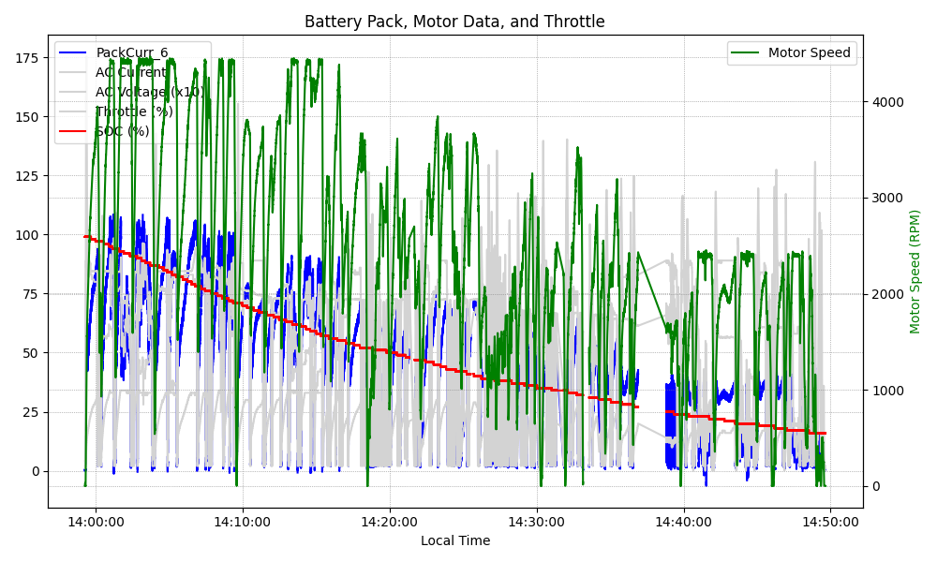
Graph Analysis

