Slide 1
Analysis Results from Folder - B4_BT06_13.03_13.56

Slide 2
Analysis Results:
Metric | Value
Total time taken for the ride | 0 days 00:49:47.380000
Actual Ampere-hours (Ah) | 27.03906388888889
Actual Watt-hours (Wh) | 1368.0779166213888
Starting SoC (Ah) | 37.854
Ending SoC (Ah) | 10.0
Starting SoC (%) | 95.0
Ending SoC (%) | 25.0
Total distance covered (km) | 26.02318639069645
Total energy consumption(WH/KM) | 52.57149897333443
Total SOC consumed(%) | 70.0
Mode | Custom mode 71.73% Eco mode 8.49% Sports mode 0.07%
Peak Power(kW) | 5454.527923
Average Power(kW) | -1652.157161971486

Slide 3
Analysis Results:
Metric | Value
Total Energy Regenerated(kWh) | 0.6062592772222223
Regenerative Effectiveness(%) | 0.044295045409155985
Highest Cell Voltage(V) | 3.345
Lowest Cell Voltage(V) | 3.0
Difference in Cell Voltage(V) | 0.3450000000000002
Minimum Temperature(C) | 37.0
Maximum Temperature(C) | 47.0
Difference in Temperature(C) | 10.0
Maximum Fet Temperature-BMS(C) | 70.0
Maximum Afe Temperature-BMS(C) | 65.0
Maximum PCB Temperature-BMS(C) | 66.0
Maximum MCU Temperature(C) | 68.0
Maximum Motor Temperature(C) | 99.0

Slide 4
Analysis Results:
Metric | Value
Abnormal Motor Temperature Detected(C) | False
highest cell temp(C) | 47.0
lowest cell temp(C) | 37.0
Difference between Highest and Lowest Cell Temperature at 100% SOC(C) | 10.0
Battery Voltage(V) | 53.0
Total energy charged(kWh) | 1.4330703861111111
Electricity consumption units(kW) | 1.3326920229430413e-07
Idling time percentage | 22.97697910185558
Time spent in 0-10 km/h | 11.894740694652857
Time spent in 10-20 km/h | 5.387402554624309
Time spent in 20-30 km/h | 6.887969842257438
Time spent in 30-40 km/h | 10.7638253486074
Time spent in 40-50 km/h | 11.133477290195074

Slide 5
Analysis Results:
Metric | Value
Time spent in 50-60 km/h | 13.534384950408082
Time spent in 60-70 km/h | 15.488782344544887
Time spent in 70-80 km/h | 1.8299601068696703
Time spent in 80-90 km/h | 0.0

Slide 6
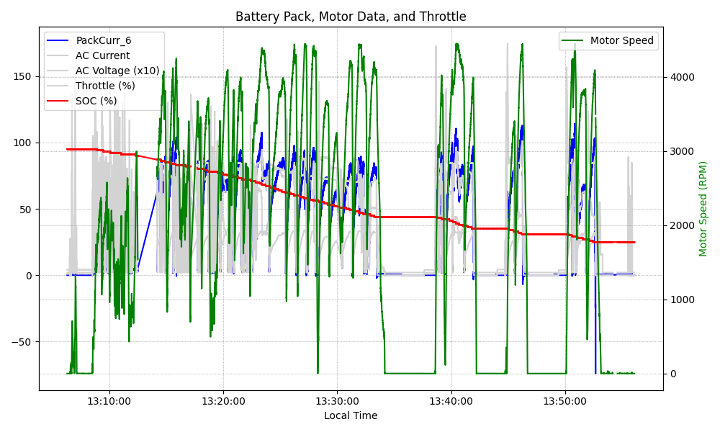
Graph Analysis

