Slide 1
Analysis Results from Folder - B4_BT06_17.05_17.45

Slide 2
Analysis Results:
Metric | Value
Total time taken for the ride | 0 days 00:39:44.831000
Actual Ampere-hours (Ah) | 20.89532472222222
Actual Watt-hours (Wh) | 1057.992809768889
Starting SoC (Ah) | 25.2
Ending SoC (Ah) | 3.429
Starting SoC (%) | 63.0
Ending SoC (%) | 8.0
Total distance covered (km) | 24.51783489577219
Total energy consumption(WH/KM) | 43.15196730325186
Total SOC consumed(%) | 55.0
Mode | Custom mode 57.25% Eco mode 42.75%
Peak Power(kW) | 5176.618119
Average Power(kW) | -1602.3450211055954

Slide 3
Analysis Results:
Metric | Value
Total Energy Regenerated(kWh) | 0.061052225
Regenerative Effectiveness(%) | 0.005770237904991706
Highest Cell Voltage(V) | 3.338
Lowest Cell Voltage(V) | 3.034
Difference in Cell Voltage(V) | 0.30400000000000027
Minimum Temperature(C) | 40.0
Maximum Temperature(C) | 47.0
Difference in Temperature(C) | 7.0
Maximum Fet Temperature-BMS(C) | 66.0
Maximum Afe Temperature-BMS(C) | 61.0
Maximum PCB Temperature-BMS(C) | 62.0
Maximum MCU Temperature(C) | 68.0
Maximum Motor Temperature(C) | 98.0

Slide 4
Analysis Results:
Metric | Value
Abnormal Motor Temperature Detected(C) | False
highest cell temp(C) | 47.0
lowest cell temp(C) | 40.0
Difference between Highest and Lowest Cell Temperature at 100% SOC(C) | 7.0
Battery Voltage(V) | 53.0
Total energy charged(kWh) | 1.1074522102777775
Electricity consumption units(kW) | 1.2903758975085962e-07
Idling time percentage | 1.060945971209572
Time spent in 0-10 km/h | 4.673770798280053
Time spent in 10-20 km/h | 6.566647971583474
Time spent in 20-30 km/h | 12.731351654514864
Time spent in 30-40 km/h | 52.182650962796785
Time spent in 40-50 km/h | 9.894372779958871

Slide 5
Analysis Results:
Metric | Value
Time spent in 50-60 km/h | 7.393905402879043
Time spent in 60-70 km/h | 4.40269209197981
Time spent in 70-80 km/h | 0.9768180968405309
Time spent in 80-90 km/h | 0.0

Slide 6
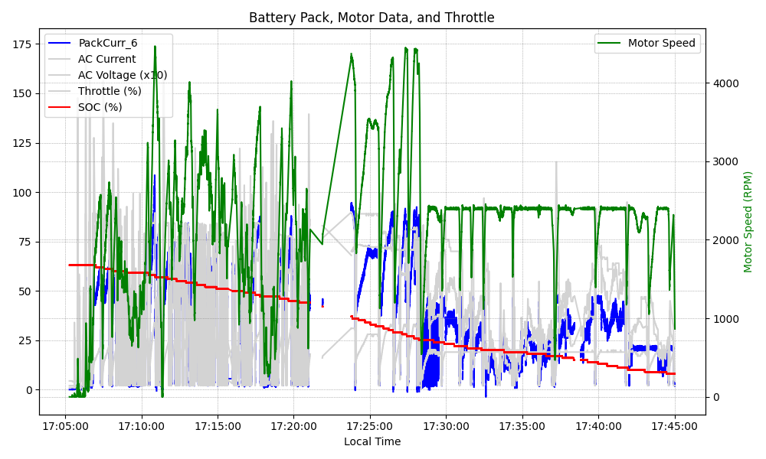
Graph Analysis

