Slide 1
Analysis Results from Folder - Battery_2

Slide 2
Analysis Results:
Metric | Value
Date and Time | 14/03/2024 17:49:49 to 14/03/2024 19:05:59
Byte Beam ID | 3
Total time taken for the ride | 0 days 01:16:10.909000
Actual Ampere-hours (Ah) | 15.348161666666666
Actual Watt-hours (Wh)- Calculated_UsingFormala | 787.2285405469445
Starting SoC (Ah) | 2.984
Ending SoC (Ah) | 19.282
Starting SoC (%) | 48.0
Ending SoC (%) | 7.0
Total distance covered (km) | 29.770408643866215
Total energy consumption(WH/KM) | 26.4433233001369
Total SOC consumed(%) | 41.0
Mode | Eco mode 98.81%

Slide 3
Analysis Results:
Metric | Value
Peak Power(kW) | 2518.2951709999998
Average Power(kW) | 622.5884767067224
Total Energy Regenerated(kWh) | 97.95537327833333
Regenerative Effectiveness(%) | 11.066104088474011
Highest Cell Voltage(V) | 3.318
Lowest Cell Voltage(V) | 3.099
Difference in Cell Voltage(V) | 0.21899999999999986
Minimum Temperature(C) | 41.0
Maximum Temperature(C) | 45.0
Difference in Temperature(C) | 4.0
Maximum Fet Temperature-BMS(C) | 49.0
Maximum Afe Temperature-BMS(C) | 52.0
Maximum PCB Temperature-BMS(C) | 50.0

Slide 4
Analysis Results:
Metric | Value
Maximum MCU Temperature(C) | 44.0
Maximum Motor Temperature(C) | 0.0
Abnormal Motor Temperature Detected(C) | False
highest cell temp(C) | 45.0
lowest cell temp(C) | 41.0
Difference between Highest and Lowest Cell Temperature at 100% SOC(C) | 4.0
Battery Voltage(V) | 54.0
Total energy charged(kWh)- Calculated_BatteryData | 0.82880073
Electricity consumption units(kW) | 5.037689824945296e-08
Cycle Count of battery | 46.0
Idling time percentage | 7.065535400819193
Time spent in 0-10 km/h | 13.32163058318705
Time spent in 10-20 km/h | 20.162863272869124

Slide 5
Analysis Results:
Metric | Value
Time spent in 20-30 km/h | 19.54359274429491
Time spent in 30-40 km/h | 29.13009557245953
Time spent in 40-50 km/h | 9.925394967817438
Time spent in 50-60 km/h | 0.0
Time spent in 60-70 km/h | 0.0
Time spent in 70-80 km/h | 0.0
Time spent in 80-90 km/h | 0.0

Slide 6
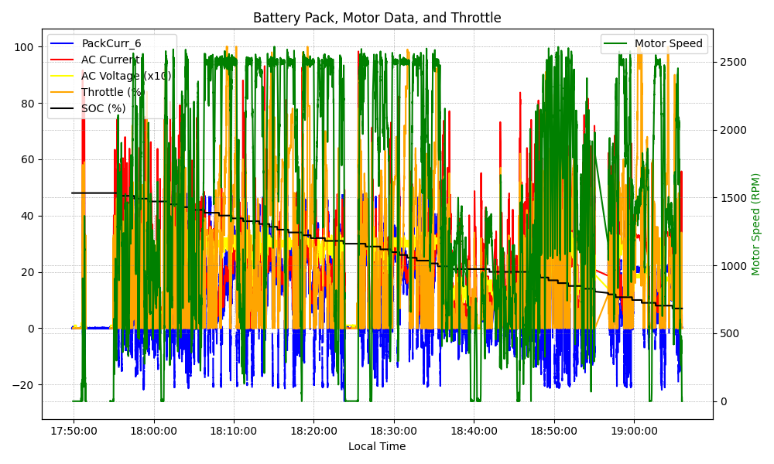
Graph Analysis

