Slide 1
Analysis Results from Folder - B4_BT02_09.56_10.40

Slide 2
Analysis Results:
Metric | Value
Date and Time | 2024-03-11 09:55:45.892000 to 2024-03-11 10:40:22.873000
Total time taken for the ride | 0 days 00:44:23.041000
Actual Ampere-hours (Ah) | 29.750206944444443
Actual Watt-hours (Wh) | 1500.779628262778
Starting SoC (Ah) | 38.875
Ending SoC (Ah) | 9.035
Starting SoC (%) | 98.0
Ending SoC (%) | 22.0
Total distance covered (km) | 30.625690105268312
Total energy consumption(WH/KM) | 49.00394482880926
Total SOC consumed(%) | 76.0
Mode | Custom mode 85.04% Eco mode 13.92% Sports mode 0.04%
Peak Power(kW) | 5427.163392

Slide 3
Analysis Results:
Metric | Value
Average Power(kW) | -2035.722178502638
Total Energy Regenerated(kWh) | 0.012831445277777775
Regenerative Effectiveness(%) | 0.000854977994777095
Highest Cell Voltage(V) | 3.329
Lowest Cell Voltage(V) | 3.017
Difference in Cell Voltage(V) | 0.3120000000000003
Minimum Temperature(C) | 26.0
Maximum Temperature(C) | 40.0
Difference in Temperature(C) | 14.0
Maximum Fet Temperature-BMS(C) | 62.0
Maximum Afe Temperature-BMS(C) | 60.0
Maximum PCB Temperature-BMS(C) | 57.0
Maximum MCU Temperature(C) | 66.0

Slide 4
Analysis Results:
Metric | Value
Maximum Motor Temperature(C) | 102.0
Abnormal Motor Temperature Detected(C) | False
highest cell temp(C) | 40.0
lowest cell temp(C) | 25.0
Difference between Highest and Lowest Cell Temperature at 100% SOC(C) | 15.0
Battery Voltage(V) | 53.0
Total energy charged(kWh) | 1.5767609680555554
Electricity consumption units(kW) | 1.6447208328697328e-07
Cycle Count of battery | 41.0
Idling time percentage | 7.641930011441196
Time spent in 0-10 km/h | 10.494338580502625
Time spent in 10-20 km/h | 5.353690772083481
Time spent in 20-30 km/h | 8.663747189016451

Slide 5
Analysis Results:
Metric | Value
Time spent in 30-40 km/h | 13.34674714956405
Time spent in 40-50 km/h | 12.246025170631633
Time spent in 50-60 km/h | 12.636603937349589
Time spent in 60-70 km/h | 19.765652739969227
Time spent in 70-80 km/h | 9.69740008679528
Time spent in 80-90 km/h | 0.0

Slide 6
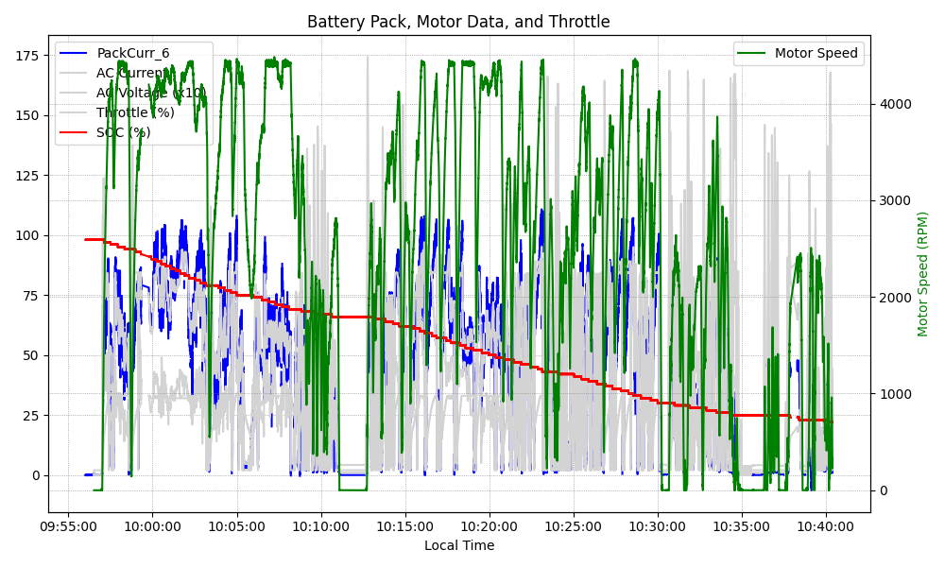
Graph Analysis

