Slide 1
Analysis Results from Folder - B4_BT02_13.59_14.50

Slide 2
Analysis Results:
Metric | Value
Date and Time | 2024-03-11 13:57:50.218000 to 2024-03-11 14:50:42.310000
Total time taken for the ride | 0 days 00:52:44.491000
Actual Ampere-hours (Ah) | 33.510839722222215
Actual Watt-hours (Wh) | 1708.2951099241668
Starting SoC (Ah) | 39.374
Ending SoC (Ah) | 6.547
Starting SoC (%) | 99.0
Ending SoC (%) | 16.0
Total distance covered (km) | 32.76320401356542
Total energy consumption(WH/KM) | 52.14066088337565
Total SOC consumed(%) | 83.0
Mode | Custom mode 77.01% Eco mode 22.80% Sports mode 0.06%
Peak Power(kW) | 5428.3737

Slide 3
Analysis Results:
Metric | Value
Average Power(kW) | -1951.0984758017132
Total Energy Regenerated(kWh) | 0.07929685166666668
Regenerative Effectiveness(%) | 0.00464165532755325
Highest Cell Voltage(V) | 3.435
Lowest Cell Voltage(V) | 3.088
Difference in Cell Voltage(V) | 0.347
Minimum Temperature(C) | 38.0
Maximum Temperature(C) | 47.0
Difference in Temperature(C) | 9.0
Maximum Fet Temperature-BMS(C) | 68.0
Maximum Afe Temperature-BMS(C) | 67.0
Maximum PCB Temperature-BMS(C) | 65.0
Maximum MCU Temperature(C) | 71.0

Slide 4
Analysis Results:
Metric | Value
Maximum Motor Temperature(C) | 101.0
Abnormal Motor Temperature Detected(C) | False
highest cell temp(C) | 47.0
lowest cell temp(C) | 38.0
Difference between Highest and Lowest Cell Temperature at 100% SOC(C) | 9.0
Battery Voltage(V) | 54.0
Total energy charged(kWh) | 1.8095853449999995
Electricity consumption units(kW) | 1.5886934128739988e-07
Cycle Count of battery | 42.0
Idling time percentage | 5.4672313246320465
Time spent in 0-10 km/h | 4.616773118578172
Time spent in 10-20 km/h | 7.720077756178839
Time spent in 20-30 km/h | 15.28742016106637

Slide 5
Analysis Results:
Metric | Value
Time spent in 30-40 km/h | 25.430435990002774
Time spent in 40-50 km/h | 11.958483754512637
Time spent in 50-60 km/h | 12.420161066370452
Time spent in 60-70 km/h | 9.587614551513468
Time spent in 70-80 km/h | 7.3486531519022495
Time spent in 80-90 km/h | 0.0

Slide 6
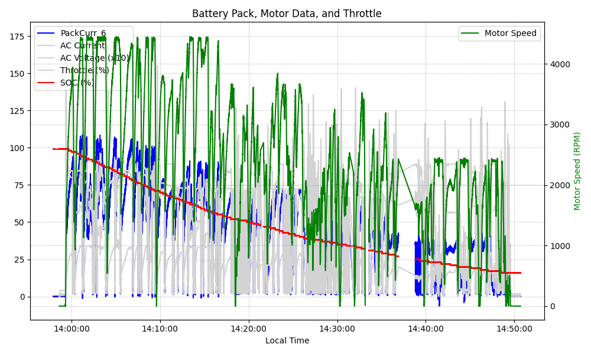
Graph Analysis

