Slide 1
Analysis Results from Folder - B4_BT04_10.45_11.45

Slide 2
Analysis Results:
Metric | Value
Date and Time | 2024-03-11 10:56:55.193000 to 2024-03-11 11:45:44.722000
Total time taken for the ride | 0 days 00:48:52.009000
Actual Ampere-hours (Ah) | 28.380030555555553
Actual Watt-hours (Wh) | 1430.0007831291666
Starting SoC (Ah) | 38.841
Ending SoC (Ah) | 10.178
Starting SoC (%) | 98.0
Ending SoC (%) | 25.0
Total distance covered (km) | 31.969494056241714
Total energy consumption(WH/KM) | 44.73016622075612
Total SOC consumed(%) | 73.0
Mode | Custom mode 97.11% Eco mode 1.34% Sports mode 0.08%
Peak Power(kW) | 5437.23852

Slide 3
Analysis Results:
Metric | Value
Average Power(kW) | -1767.8581110113323
Total Energy Regenerated(kWh) | 0.045046905
Regenerative Effectiveness(%) | 0.003150032261478203
Highest Cell Voltage(V) | 3.326
Lowest Cell Voltage(V) | 3.0
Difference in Cell Voltage(V) | 0.32600000000000007
Minimum Temperature(C) | 27.0
Maximum Temperature(C) | 41.0
Difference in Temperature(C) | 14.0
Maximum Fet Temperature-BMS(C) | 67.0
Maximum Afe Temperature-BMS(C) | 60.0
Maximum PCB Temperature-BMS(C) | 59.0
Maximum MCU Temperature(C) | 59.0

Slide 4
Analysis Results:
Metric | Value
Maximum Motor Temperature(C) | 97.0
Abnormal Motor Temperature Detected(C) | False
highest cell temp(C) | 41.0
lowest cell temp(C) | 27.0
Difference between Highest and Lowest Cell Temperature at 100% SOC(C) | 14.0
Battery Voltage(V) | 53.0
Total energy charged(kWh) | 1.5041416194444444
Electricity consumption units(kW) | 1.4250242718702104e-07
Cycle Count of battery | 26.0
Idling time percentage | 20.110361741263027
Time spent in 0-10 km/h | 3.6534785588054968
Time spent in 10-20 km/h | 5.106935478053883
Time spent in 20-30 km/h | 10.859451076567966

Slide 5
Analysis Results:
Metric | Value
Time spent in 30-40 km/h | 10.520431348505067
Time spent in 40-50 km/h | 7.837126266815739
Time spent in 50-60 km/h | 10.091246799148843
Time spent in 60-70 km/h | 13.272261694377322
Time spent in 70-80 km/h | 18.37559057957947
Time spent in 80-90 km/h | 0.0

Slide 6
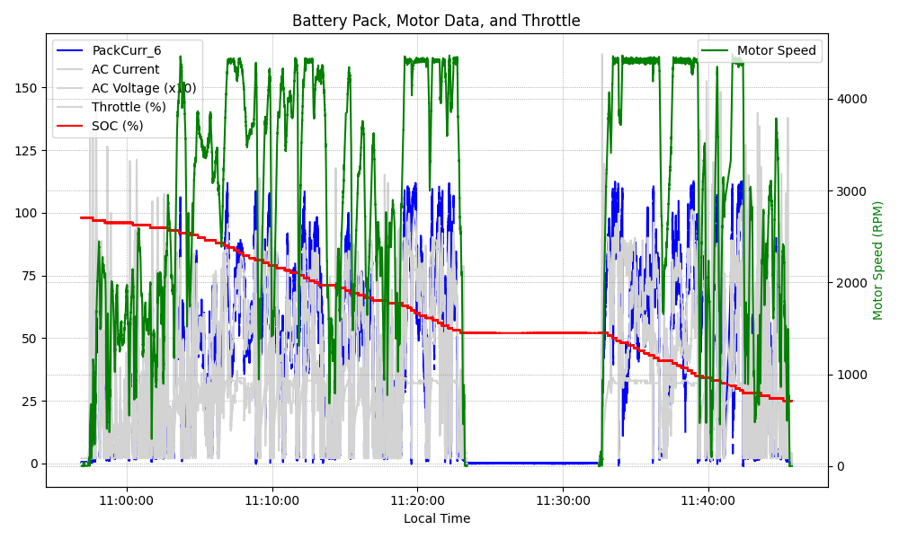
Graph Analysis

