Slide 1
Analysis Results from Folder - B4_BT04_15.52_16.57

Slide 2
Analysis Results:
Metric | Value
Date and Time | 2024-03-11 16:05:22.553000 to 2024-03-11 16:57:30.743000
Total time taken for the ride | 0 days 00:52:10.640000
Actual Ampere-hours (Ah) | 32.97601722222222
Actual Watt-hours (Wh) | 1673.844472675
Starting SoC (Ah) | 39.268
Ending SoC (Ah) | 7.33
Starting SoC (%) | 99.0
Ending SoC (%) | 18.0
Total distance covered (km) | 30.986615690755627
Total energy consumption(WH/KM) | 54.01830549614895
Total SOC consumed(%) | 81.0
Mode | Custom mode 69.63% Eco mode 18.00% Sports mode 0.06%
Peak Power(kW) | 5421.410500000001

Slide 3
Analysis Results:
Metric | Value
Average Power(kW) | -1935.0803152312137
Total Energy Regenerated(kWh) | 1.4474072980555555
Regenerative Effectiveness(%) | 0.08639732069129558
Highest Cell Voltage(V) | 3.332
Lowest Cell Voltage(V) | 3.071
Difference in Cell Voltage(V) | 0.2609999999999997
Minimum Temperature(C) | 38.0
Maximum Temperature(C) | 48.0
Difference in Temperature(C) | 10.0
Maximum Fet Temperature-BMS(C) | 70.0
Maximum Afe Temperature-BMS(C) | 66.0
Maximum PCB Temperature-BMS(C) | 65.0
Maximum MCU Temperature(C) | 68.0

Slide 4
Analysis Results:
Metric | Value
Maximum Motor Temperature(C) | 100.0
Abnormal Motor Temperature Detected(C) | False
highest cell temp(C) | 48.0
lowest cell temp(C) | 38.0
Difference between Highest and Lowest Cell Temperature at 100% SOC(C) | 10.0
Battery Voltage(V) | 53.0
Total energy charged(kWh) | 1.7477289127777775
Electricity consumption units(kW) | 1.551055123160967e-07
Cycle Count of battery | 27.0
Idling time percentage | 15.93362445414847
Time spent in 0-10 km/h | 8.419213973799126
Time spent in 10-20 km/h | 3.8148471615720525
Time spent in 20-30 km/h | 8.978165938864628

Slide 5
Analysis Results:
Metric | Value
Time spent in 30-40 km/h | 17.753711790393012
Time spent in 40-50 km/h | 11.832314410480349
Time spent in 50-60 km/h | 11.741484716157204
Time spent in 60-70 km/h | 13.956331877729259
Time spent in 70-80 km/h | 7.479475982532752
Time spent in 80-90 km/h | 0.0

Slide 6
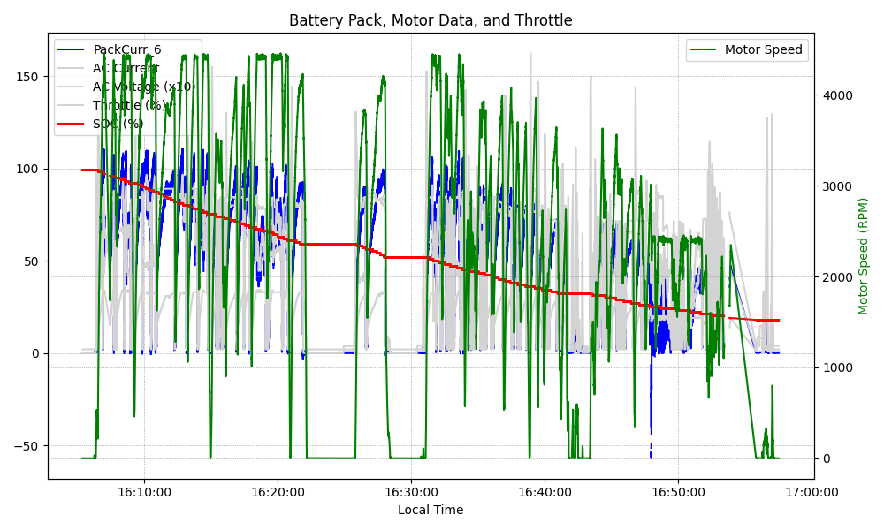
Graph Analysis

