Slide 1
Analysis Results from Folder - B4_BT05_11.47_12.42

Slide 2
Analysis Results:
Metric | Value
Date and Time | 2024-03-11 11:56:50.902000 to 2024-03-11 12:41:15.782000
Total time taken for the ride | 0 days 00:44:26.820000
Actual Ampere-hours (Ah) | 27.482442499999998
Actual Watt-hours (Wh) | 1392.5128395005554
Starting SoC (Ah) | 38.734
Ending SoC (Ah) | 11.11
Starting SoC (%) | 97.0
Ending SoC (%) | 28.0
Total distance covered (km) | 28.990432993729527
Total energy consumption(WH/KM) | 48.03353022708382
Total SOC consumed(%) | 69.0
Mode | Custom mode 94.60% Eco mode 3.25% Sports mode 0.11%
Peak Power(kW) | 5527.275720000001

Slide 3
Analysis Results:
Metric | Value
Average Power(kW) | -1882.48074434923
Total Energy Regenerated(kWh) | 0.12604075305555557
Regenerative Effectiveness(%) | 0.009050497931854558
Highest Cell Voltage(V) | 3.328
Lowest Cell Voltage(V) | 3.06
Difference in Cell Voltage(V) | 0.2679999999999998
Minimum Temperature(C) | 28.0
Maximum Temperature(C) | 45.0
Difference in Temperature(C) | 17.0
Maximum Fet Temperature-BMS(C) | 70.0
Maximum Afe Temperature-BMS(C) | 67.0
Maximum PCB Temperature-BMS(C) | 66.0
Maximum MCU Temperature(C) | 64.0

Slide 4
Analysis Results:
Metric | Value
Maximum Motor Temperature(C) | 102.0
Abnormal Motor Temperature Detected(C) | False
highest cell temp(C) | 45.0
lowest cell temp(C) | 28.0
Difference between Highest and Lowest Cell Temperature at 100% SOC(C) | 17.0
Battery Voltage(V) | 53.0
Total energy charged(kWh) | 1.4565694525
Electricity consumption units(kW) | 1.5176392561682085e-07
Cycle Count of battery | 39.0
Idling time percentage | 14.162725839699283
Time spent in 0-10 km/h | 5.363566549452326
Time spent in 10-20 km/h | 6.798431752960672
Time spent in 20-30 km/h | 10.023847055494928

Slide 5
Analysis Results:
Metric | Value
Time spent in 30-40 km/h | 10.977729275292026
Time spent in 40-50 km/h | 9.16696980720262
Time spent in 50-60 km/h | 15.569297926518736
Time spent in 60-70 km/h | 15.03981245705509
Time spent in 70-80 km/h | 12.764237500505235
Time spent in 80-90 km/h | 0.0

Slide 6
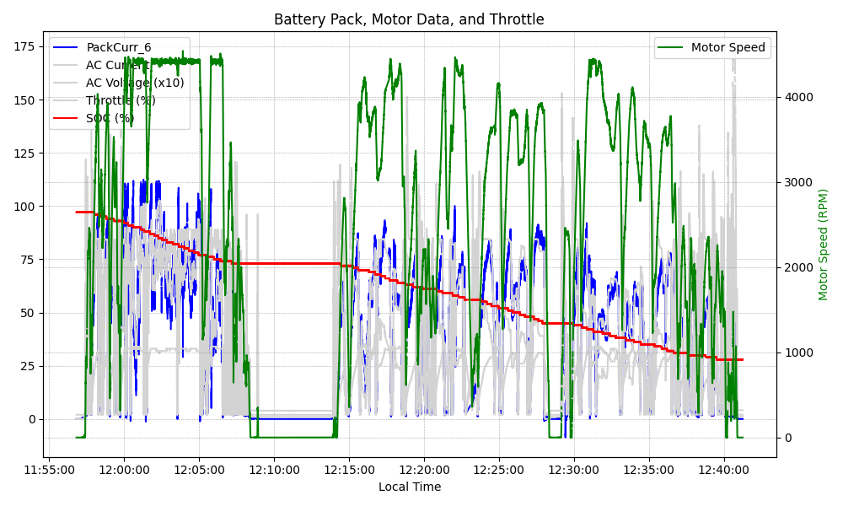
Graph Analysis

