Slide 1
Analysis Results from Folder - B4_B02_09.59_10.41

Slide 2
Analysis Results:
Metric | Value
Date and Time | 2024-03-12 09:59:28.512000 to 2024-03-12 10:41:56.064000
Total time taken for the ride | 0 days 00:42:32.618000
Actual Ampere-hours (Ah) | 32.19162166666667
Actual Watt-hours (Wh) | 1632.661795212778
Starting SoC (Ah) | 39.551
Ending SoC (Ah) | 7.43
Starting SoC (%) | 99.0
Ending SoC (%) | 18.0
Total distance covered (km) | 35.8652854330722
Total energy consumption(WH/KM) | 45.5220633405935
Total SOC consumed(%) | 81.0
Mode | Custom mode 76.57% Eco mode 19.91% Sports mode 0.31%
Peak Power(kW) | 5490.365296

Slide 3
Analysis Results:
Metric | Value
Average Power(kW) | -2312.1882229606613
Total Energy Regenerated(kWh) | 0.4675920697222222
Regenerative Effectiveness(%) | 0.028631660991679762
Highest Cell Voltage(V) | 3.443
Lowest Cell Voltage(V) | 3.039
Difference in Cell Voltage(V) | 0.4039999999999999
Minimum Temperature(C) | 35.0
Maximum Temperature(C) | 47.0
Difference in Temperature(C) | 12.0
Maximum Fet Temperature-BMS(C) | 70.0
Maximum Afe Temperature-BMS(C) | 68.0
Maximum PCB Temperature-BMS(C) | 66.0
Maximum MCU Temperature(C) | 56.0

Slide 4
Analysis Results:
Metric | Value
Maximum Motor Temperature(C) | 97.0
Abnormal Motor Temperature Detected(C) | False
highest cell temp(C) | 47.0
lowest cell temp(C) | 35.0
Difference between Highest and Lowest Cell Temperature at 100% SOC(C) | 12.0
Battery Voltage(V) | 54.0
Total energy charged(kWh) | 1.7383475700000002
Electricity consumption units(kW) | 1.892140771943574e-07
Cycle Count of battery | 45.0
Idling time percentage | 5.573094799614137
Time spent in 0-10 km/h | 3.183372796632465
Time spent in 10-20 km/h | 3.2886082609839518
Time spent in 20-30 km/h | 4.937297202490573

Slide 5
Analysis Results:
Metric | Value
Time spent in 30-40 km/h | 24.239235288959048
Time spent in 40-50 km/h | 6.585986143997194
Time spent in 50-60 km/h | 5.371393492940454
Time spent in 60-70 km/h | 18.23204419889503
Time spent in 70-80 km/h | 28.43549942997457
Time spent in 80-90 km/h | 0.0

Slide 6
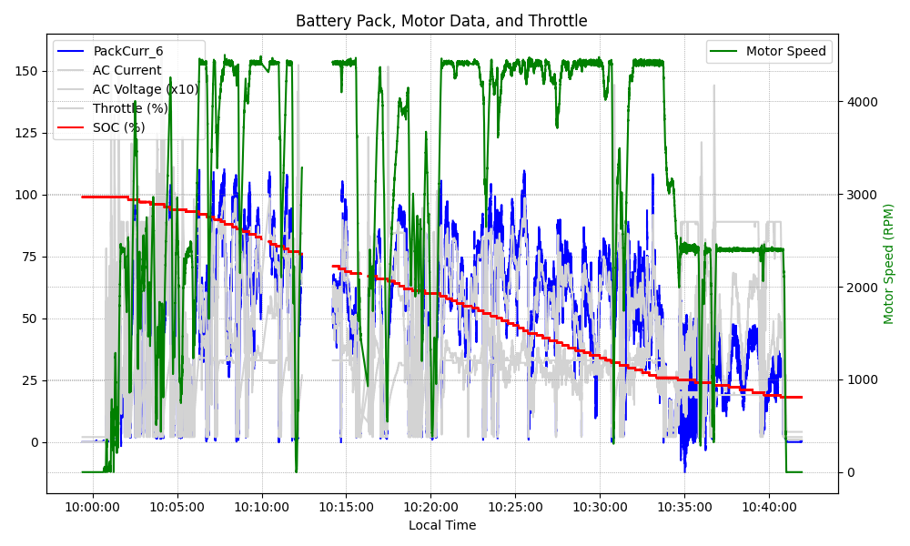
Graph Analysis

