Slide 1
Analysis Results from Folder - B4_B02_16.59_18.03

Slide 2
Analysis Results:
Metric | Value
Date and Time | 2024-03-12 16:59:29.259000 to 2024-03-12 18:03:22.519000
Total time taken for the ride | 0 days 01:03:45.240000
Actual Ampere-hours (Ah) | 27.283976111111112
Actual Watt-hours (Wh) | 1403.2693823775
Starting SoC (Ah) | 39.512
Ending SoC (Ah) | 12.605
Starting SoC (%) | 99.0
Ending SoC (%) | 31.0
Total distance covered (km) | 30.988486215027667
Total energy consumption(WH/KM) | 45.283573151662814
Total SOC consumed(%) | 68.0
Mode | Custom mode 97.62% Eco mode 0.11%
Peak Power(kW) | 4861.082784

Slide 3
Analysis Results:
Metric | Value
Average Power(kW) | -1326.6202144325105
Total Energy Regenerated(kWh) | 0.010689247222222222
Regenerative Effectiveness(%) | 0.0007617329881871818
Highest Cell Voltage(V) | 3.436
Lowest Cell Voltage(V) | 3.095
Difference in Cell Voltage(V) | 0.34099999999999975
Minimum Temperature(C) | 38.0
Maximum Temperature(C) | 44.0
Difference in Temperature(C) | 6.0
Maximum Fet Temperature-BMS(C) | 58.0
Maximum Afe Temperature-BMS(C) | 59.0
Maximum PCB Temperature-BMS(C) | 56.0
Maximum MCU Temperature(C) | 54.0

Slide 4
Analysis Results:
Metric | Value
Maximum Motor Temperature(C) | 94.0
Abnormal Motor Temperature Detected(C) | False
highest cell temp(C) | 44.0
lowest cell temp(C) | 38.0
Difference between Highest and Lowest Cell Temperature at 100% SOC(C) | 6.0
Battery Voltage(V) | 54.0
Total energy charged(kWh) | 1.47333471
Electricity consumption units(kW) | 1.0699598474945533e-07
Cycle Count of battery | 46.0
Idling time percentage | 2.50272034820457
Time spent in 0-10 km/h | 24.199644922971192
Time spent in 10-20 km/h | 7.4852528492068044
Time spent in 20-30 km/h | 11.448370654601684

Slide 5
Analysis Results:
Metric | Value
Time spent in 30-40 km/h | 14.70706145123418
Time spent in 40-50 km/h | 20.273752935112537
Time spent in 50-60 km/h | 16.399404386919418
Time spent in 60-70 km/h | 2.8950231945478495
Time spent in 70-80 km/h | 0.0
Time spent in 80-90 km/h | 0.0

Slide 6
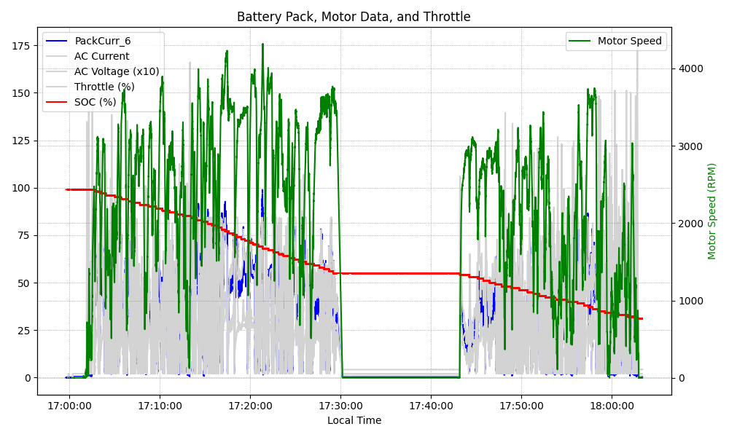
Graph Analysis

