Slide 1
Analysis Results from Folder - B4_B04_09.18_09.42

Slide 2
Analysis Results:
Metric | Value
Date and Time | 2024-03-12 09:18:59.230000 to 2024-03-12 09:41:58.586000
Total time taken for the ride | 0 days 00:22:55.296000
Actual Ampere-hours (Ah) | 7.712716944444444
Actual Watt-hours (Wh) | 391.59873830777775
Starting SoC (Ah) | 12.152
Ending SoC (Ah) | 4.983
Starting SoC (%) | 30.0
Ending SoC (%) | 12.0
Total distance covered (km) | 11.775020637923902
Total energy consumption(WH/KM) | 33.25673477348758
Total SOC consumed(%) | 18.0
Mode | Eco mode 97.32%
Peak Power(kW) | 2444.592456

Slide 3
Analysis Results:
Metric | Value
Average Power(kW) | -1028.2680218147336
Total Energy Regenerated(kWh) | 0.16853143916666669
Regenerative Effectiveness(%) | 0.04301825399439998
Highest Cell Voltage(V) | 3.295
Lowest Cell Voltage(V) | 3.086
Difference in Cell Voltage(V) | 0.20900000000000007
Minimum Temperature(C) | 26.0
Maximum Temperature(C) | 29.0
Difference in Temperature(C) | 3.0
Maximum Fet Temperature-BMS(C) | 35.0
Maximum Afe Temperature-BMS(C) | 38.0
Maximum PCB Temperature-BMS(C) | 37.0
Maximum MCU Temperature(C) | 46.0

Slide 4
Analysis Results:
Metric | Value
Maximum Motor Temperature(C) | 77.0
Abnormal Motor Temperature Detected(C) | False
highest cell temp(C) | 29.0
lowest cell temp(C) | 26.0
Difference between Highest and Lowest Cell Temperature at 100% SOC(C) | 3.0
Battery Voltage(V) | 52.0
Total energy charged(kWh) | 0.4010612811111111
Electricity consumption units(kW) | 8.10224810325477e-08
Cycle Count of battery | 27.0
Idling time percentage | 4.847366655484737
Time spent in 0-10 km/h | 8.185172760818517
Time spent in 10-20 km/h | 5.182824555518282
Time spent in 20-30 km/h | 8.092921838309291

Slide 5
Analysis Results:
Metric | Value
Time spent in 30-40 km/h | 73.61623616236163
Time spent in 40-50 km/h | 0.008386447500838645
Time spent in 50-60 km/h | 0.0
Time spent in 60-70 km/h | 0.0
Time spent in 70-80 km/h | 0.0
Time spent in 80-90 km/h | 0.0

Slide 6
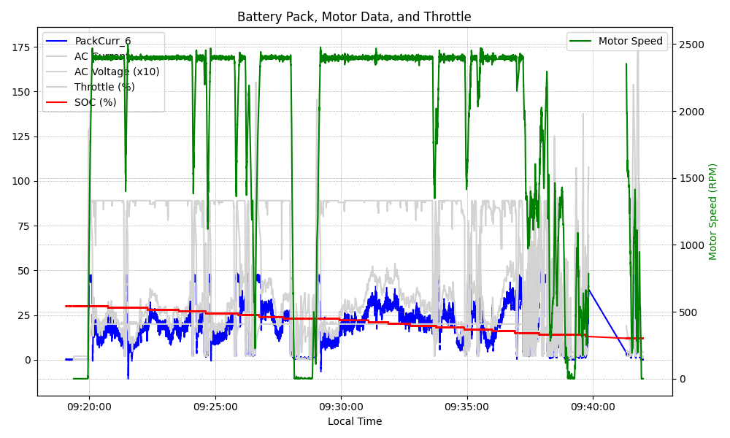
Graph Analysis

