Slide 1
Analysis Results from Folder - B4_B05_06.07_06.55

Slide 2
Analysis Results:
Metric | Value
Date and Time | 2024-03-12 06:07:03.586000 to 2024-03-12 06:55:17.324000
Total time taken for the ride | 0 days 00:48:16.837000
Actual Ampere-hours (Ah) | 28.521484166666667
Actual Watt-hours (Wh) | 1436.9600906974997
Starting SoC (Ah) | 9.852
Ending SoC (Ah) | 10.197
Starting SoC (%) | 99.0
Ending SoC (%) | 24.0
Total distance covered (km) | 29.81116975955862
Total energy consumption(WH/KM) | 48.20206997200284
Total SOC consumed(%) | 75.0
Mode | Custom mode 74.60% Eco mode 20.45% Sports mode 0.04%
Peak Power(kW) | 5563.598616

Slide 3
Analysis Results:
Metric | Value
Average Power(kW) | -1797.4483413867267
Total Energy Regenerated(kWh) | 0.7363970408333332
Regenerative Effectiveness(%) | 0.05122061903286506
Highest Cell Voltage(V) | 3.335
Lowest Cell Voltage(V) | 3.021
Difference in Cell Voltage(V) | 0.31400000000000006
Minimum Temperature(C) | 25.0
Maximum Temperature(C) | 43.0
Difference in Temperature(C) | 18.0
Maximum Fet Temperature-BMS(C) | 71.0
Maximum Afe Temperature-BMS(C) | 65.0
Maximum PCB Temperature-BMS(C) | 64.0
Maximum MCU Temperature(C) | 54.0

Slide 4
Analysis Results:
Metric | Value
Maximum Motor Temperature(C) | 92.0
Abnormal Motor Temperature Detected(C) | False
highest cell temp(C) | 43.0
lowest cell temp(C) | 25.0
Difference between Highest and Lowest Cell Temperature at 100% SOC(C) | 18.0
Battery Voltage(V) | 53.0
Total energy charged(kWh) | 1.5116386608333334
Electricity consumption units(kW) | 1.4499296547281052e-07
Cycle Count of battery | 52.0
Idling time percentage | 21.823692851730232
Time spent in 0-10 km/h | 6.05792708596447
Time spent in 10-20 km/h | 3.2794476719710364
Time spent in 20-30 km/h | 5.430664309168982

Slide 5
Analysis Results:
Metric | Value
Time spent in 30-40 km/h | 10.478235244590385
Time spent in 40-50 km/h | 8.832196682663973
Time spent in 50-60 km/h | 17.643344278858297
Time spent in 60-70 km/h | 14.427043866296202
Time spent in 70-80 km/h | 11.939041845583901
Time spent in 80-90 km/h | 0.0

Slide 6
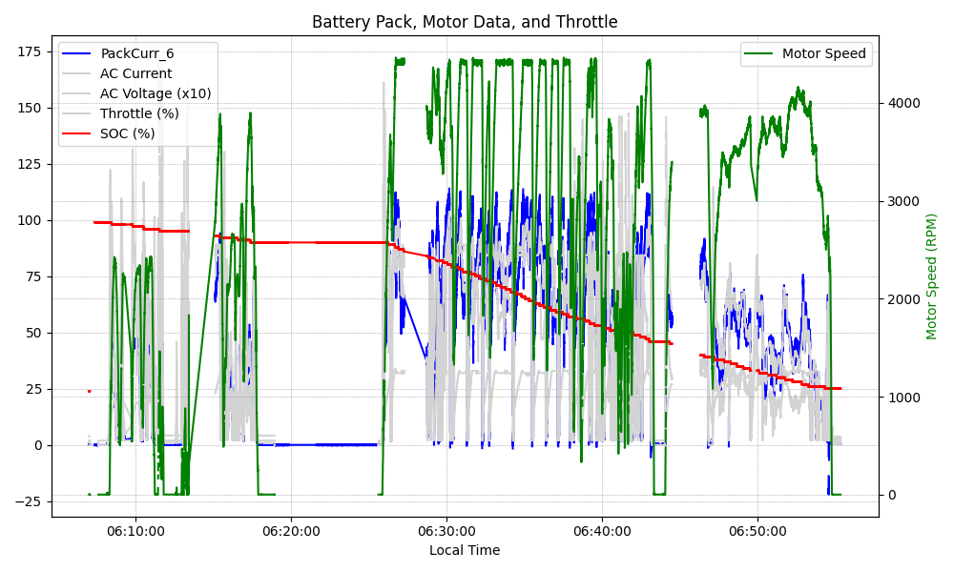
Graph Analysis

