Slide 1
Analysis Results from Folder - B4_B06_08.13_09.18

Slide 2
Analysis Results:
Metric | Value
Date and Time | 2024-03-12 08:13:59.622000 to 2024-03-12 09:18:37.211000
Total time taken for the ride | 0 days 01:04:26.248000
Actual Ampere-hours (Ah) | 31.876796666666664
Actual Watt-hours (Wh) | 1597.140168137222
Starting SoC (Ah) | 35.322
Ending SoC (Ah) | 3.45
Starting SoC (%) | 89.0
Ending SoC (%) | 8.0
Total distance covered (km) | 35.2506607867321
Total energy consumption(WH/KM) | 45.3080916071328
Total SOC consumed(%) | 81.0
Mode | Custom mode 52.47% Eco mode 42.89%
Peak Power(kW) | 5429.2873850000005

Slide 3
Analysis Results:
Metric | Value
Average Power(kW) | -1497.3189076286458
Total Energy Regenerated(kWh) | 0.60077226
Regenerative Effectiveness(%) | 0.0376013560653105
Highest Cell Voltage(V) | 3.371
Lowest Cell Voltage(V) | 2.98
Difference in Cell Voltage(V) | 0.391
Minimum Temperature(C) | 26.0
Maximum Temperature(C) | 39.0
Difference in Temperature(C) | 13.0
Maximum Fet Temperature-BMS(C) | 63.0
Maximum Afe Temperature-BMS(C) | 58.0
Maximum PCB Temperature-BMS(C) | 59.0
Maximum MCU Temperature(C) | 54.0

Slide 4
Analysis Results:
Metric | Value
Maximum Motor Temperature(C) | 89.0
Abnormal Motor Temperature Detected(C) | False
highest cell temp(C) | 39.0
lowest cell temp(C) | 26.0
Difference between Highest and Lowest Cell Temperature at 100% SOC(C) | 13.0
Battery Voltage(V) | 53.0
Total energy charged(kWh) | 1.6894702233333332
Electricity consumption units(kW) | 1.213909167768389e-07
Cycle Count of battery | 39.0
Idling time percentage | 22.70450751252087
Time spent in 0-10 km/h | 2.8992765720645517
Time spent in 10-20 km/h | 4.774624373956595
Time spent in 20-30 km/h | 9.315525876460768

Slide 5
Analysis Results:
Metric | Value
Time spent in 30-40 km/h | 30.283806343906512
Time spent in 40-50 km/h | 5.779076238174736
Time spent in 50-60 km/h | 8.597662771285476
Time spent in 60-70 km/h | 11.47746243739566
Time spent in 70-80 km/h | 4.067890929326656
Time spent in 80-90 km/h | 0.0

Slide 6
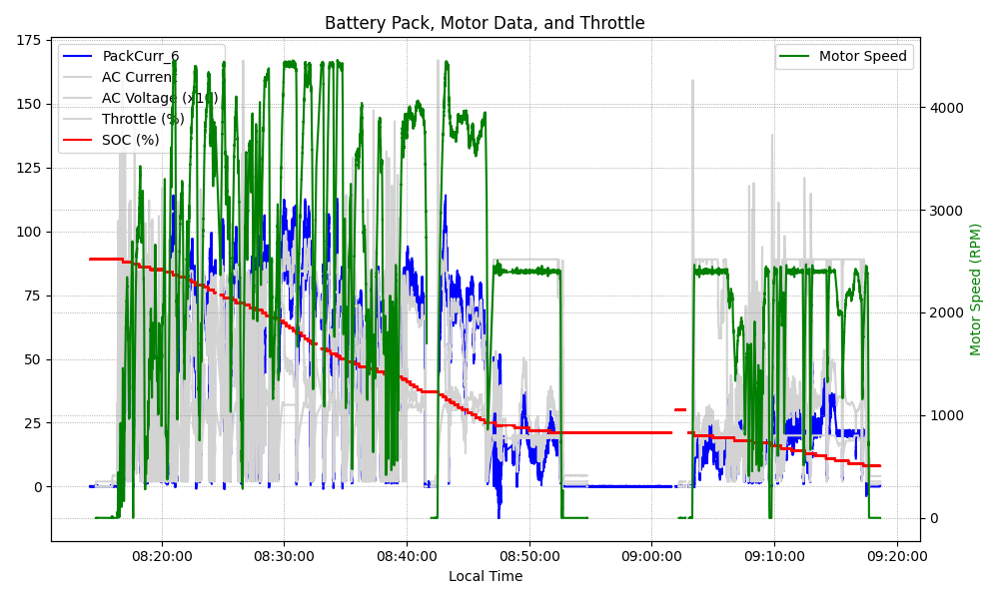
Graph Analysis

