Slide 1
Analysis Results from Folder - B4_B06_15.58_16.56

Slide 2
Analysis Results:
Metric | Value
Date and Time | 2024-03-12 15:58:10.534000 to 2024-03-12 16:56:55.260000
Total time taken for the ride | 0 days 00:58:37.185000
Actual Ampere-hours (Ah) | 33.038110833333334
Actual Watt-hours (Wh) | 1691.0718167533332
Starting SoC (Ah) | 39.476
Ending SoC (Ah) | 7.414
Starting SoC (%) | 99.0
Ending SoC (%) | 18.0
Total distance covered (km) | 40.782274200087784
Total energy consumption(WH/KM) | 41.46585372989556
Total SOC consumed(%) | 81.0
Mode | Custom mode 74.37% Eco mode 20.71% Sports mode 1.64%
Peak Power(kW) | 4502.33508

Slide 3
Analysis Results:
Metric | Value
Average Power(kW) | -1738.8913282810624
Total Energy Regenerated(kWh) | 0.0764918
Regenerative Effectiveness(%) | 0.004523068710953785
Highest Cell Voltage(V) | 3.394
Lowest Cell Voltage(V) | 3.094
Difference in Cell Voltage(V) | 0.30000000000000027
Minimum Temperature(C) | 36.0
Maximum Temperature(C) | 45.0
Difference in Temperature(C) | 9.0
Maximum Fet Temperature-BMS(C) | 61.0
Maximum Afe Temperature-BMS(C) | 60.0
Maximum PCB Temperature-BMS(C) | 60.0
Maximum MCU Temperature(C) | 50.0

Slide 4
Analysis Results:
Metric | Value
Maximum Motor Temperature(C) | 95.0
Abnormal Motor Temperature Detected(C) | False
highest cell temp(C) | 45.0
lowest cell temp(C) | 36.0
Difference between Highest and Lowest Cell Temperature at 100% SOC(C) | 9.0
Battery Voltage(V) | 53.0
Total energy charged(kWh) | 1.7510198741666667
Electricity consumption units(kW) | 1.3829809766583473e-07
Cycle Count of battery | 41.0
Idling time percentage | 10.214501416518788
Time spent in 0-10 km/h | 4.321160611438
Time spent in 10-20 km/h | 2.3753930450484106
Time spent in 20-30 km/h | 5.220883534136546

Slide 5
Analysis Results:
Metric | Value
Time spent in 30-40 km/h | 10.880732231250583
Time spent in 40-50 km/h | 11.017714267924411
Time spent in 50-60 km/h | 51.5457177547399
Time spent in 60-70 km/h | 4.342953208181564
Time spent in 70-80 km/h | 0.0
Time spent in 80-90 km/h | 0.0

Slide 6
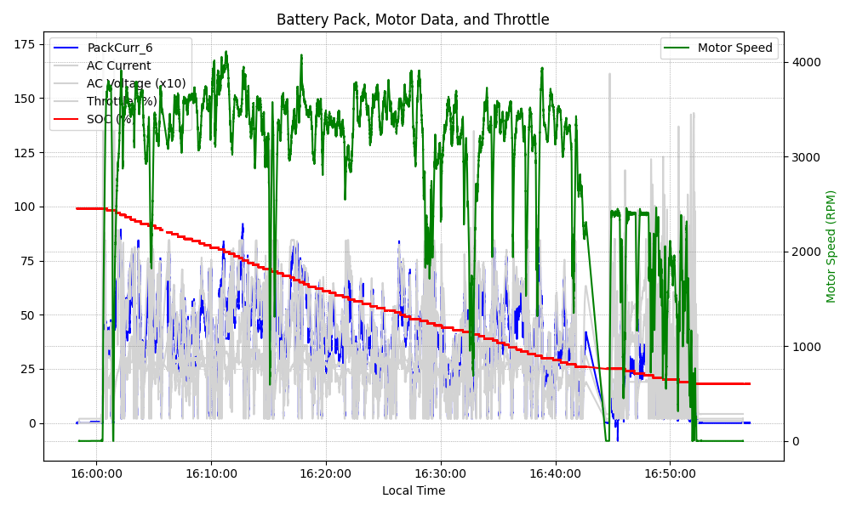
Graph Analysis

