Slide 1
Analysis Results from Folder - B3_B05_17.46_20.05

Slide 2
Analysis Results:
Metric | Value
Date and Time | 2024-03-11 17:42:37.788000 to 2024-03-11 20:01:41.810000
Total time taken for the ride | 0 days 02:18:39.757000
Actual Ampere-hours (Ah) | 33.665416388888886
Actual Watt-hours (Wh) | 1739.5021568341665
Starting SoC (Ah) | 39.6
Ending SoC (Ah) | 5.579
Starting SoC (%) | 99.0
Ending SoC (%) | 14.0
Total distance covered (km) | 60.66392335791602
Total energy consumption(WH/KM) | 28.6744091141474
Total SOC consumed(%) | 85.0
Mode | Eco mode 50.43% Sports mode 41.24% Custom mode 3.00%
Peak Power(kW) | 6033.005824

Slide 3
Analysis Results:
Metric | Value
Average Power(kW) | -755.6664371428743
Total Energy Regenerated(kWh) | 95.97401529333334
Regenerative Effectiveness(%) | 5.228834716066615
Highest Cell Voltage(V) | 3.34
Lowest Cell Voltage(V) | 3.107
Difference in Cell Voltage(V) | 0.23299999999999965
Minimum Temperature(C) | 31.0
Maximum Temperature(C) | 38.0
Difference in Temperature(C) | 7.0
Maximum Fet Temperature-BMS(C) | 47.0
Maximum Afe Temperature-BMS(C) | 47.0
Maximum PCB Temperature-BMS(C) | 45.0
Maximum MCU Temperature(C) | 46.0

Slide 4
Analysis Results:
Metric | Value
Maximum Motor Temperature(C) | 0.0
Abnormal Motor Temperature Detected(C) | False
highest cell temp(C) | 42.0
lowest cell temp(C) | 31.0
Difference between Highest and Lowest Cell Temperature at 100% SOC(C) | 11.0
Battery Voltage(V) | 55.0
Total energy charged(kWh) | 1.8515979013888886
Electricity consumption units(kW) | 6.182627123281674e-08
Cycle Count of battery | 136.0
Idling time percentage | 9.657230379211999
Time spent in 0-10 km/h | 9.07494454420619
Time spent in 10-20 km/h | 10.384757578958487
Time spent in 20-30 km/h | 21.835058624696313

Slide 5
Analysis Results:
Metric | Value
Time spent in 30-40 km/h | 41.82291116509982
Time spent in 40-50 km/h | 6.743160452096757
Time spent in 50-60 km/h | 0.05809654589627126
Time spent in 60-70 km/h | 0.025087144818844404
Time spent in 70-80 km/h | 0.0
Time spent in 80-90 km/h | 0.0

Slide 6
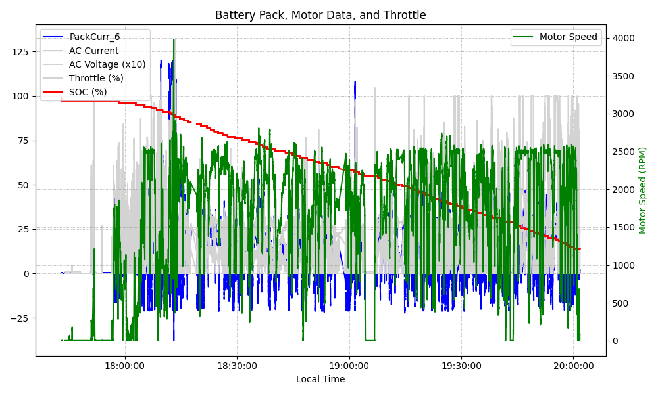
Graph Analysis

