Slide 1
Analysis Results from Folder - B3_B07_16.40_17.38

Slide 2
Analysis Results:
Metric | Value
Date and Time | 2024-03-11 16:37:01.599000 to 2024-03-11 17:36:23.668000
Total time taken for the ride | 0 days 00:59:17.031000
Actual Ampere-hours (Ah) | 25.200022777777775
Actual Watt-hours (Wh) | 1288.723236378611
Starting SoC (Ah) | 38.279
Ending SoC (Ah) | 12.818
Starting SoC (%) | 96.0
Ending SoC (%) | 32.0
Total distance covered (km) | 31.11078368427709
Total energy consumption(WH/KM) | 41.423682844412305
Total SOC consumed(%) | 64.0
Mode | Custom mode 59.03% Eco mode 34.13% Sports mode 0.03%
Peak Power(kW) | 6127.99704

Slide 3
Analysis Results:
Metric | Value
Average Power(kW) | -1311.3068544270775
Total Energy Regenerated(kWh) | 55.21605070694445
Regenerative Effectiveness(%) | 4.108522701697714
Highest Cell Voltage(V) | 3.334
Lowest Cell Voltage(V) | 3.09
Difference in Cell Voltage(V) | 0.24400000000000022
Minimum Temperature(C) | 32.0
Maximum Temperature(C) | 42.0
Difference in Temperature(C) | 10.0
Maximum Fet Temperature-BMS(C) | 69.0
Maximum Afe Temperature-BMS(C) | 65.0
Maximum PCB Temperature-BMS(C) | 64.0
Maximum MCU Temperature(C) | 53.0

Slide 4
Analysis Results:
Metric | Value
Maximum Motor Temperature(C) | 0.0
Abnormal Motor Temperature Detected(C) | False
highest cell temp(C) | 42.0
lowest cell temp(C) | -52.0
Difference between Highest and Lowest Cell Temperature at 100% SOC(C) | 94.0
Battery Voltage(V) | 55.0
Total energy charged(kWh) | 1.3860012527777776
Electricity consumption units(kW) | 1.082373764390855e-07
Cycle Count of battery | 42.0
Idling time percentage | 3.9940242080551234
Time spent in 0-10 km/h | 23.915363273270525
Time spent in 10-20 km/h | 4.378182261654319
Time spent in 20-30 km/h | 8.856977346870332

Slide 5
Analysis Results:
Metric | Value
Time spent in 30-40 km/h | 18.68044757462118
Time spent in 40-50 km/h | 14.793133937010275
Time spent in 50-60 km/h | 19.07984999542669
Time spent in 60-70 km/h | 5.884325741638465
Time spent in 70-80 km/h | 0.0
Time spent in 80-90 km/h | 0.0

Slide 6
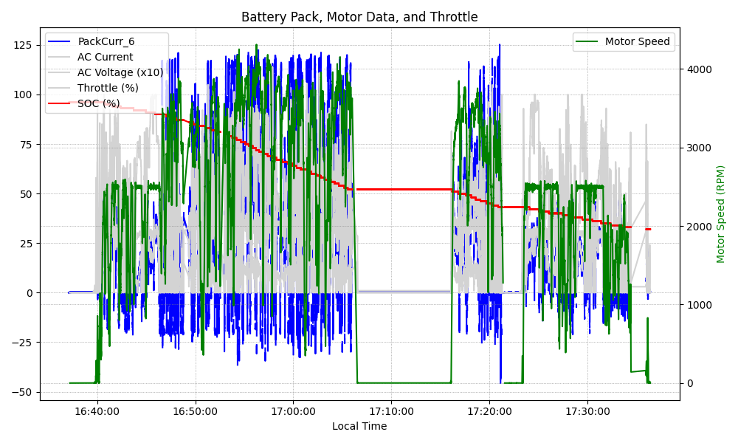
Graph Analysis

