Slide 1
Analysis Results from Folder - B3_B15_15.33_16.39

Slide 2
Analysis Results:
Metric | Value
Date and Time | 2024-03-11 15:31:19.824000 to 2024-03-11 16:36:21.599000
Total time taken for the ride | 0 days 01:04:50.725000
Actual Ampere-hours (Ah) | 23.295388888888887
Actual Watt-hours (Wh) | 1202.0196433216668
Starting SoC (Ah) | 38.411
Ending SoC (Ah) | 14.015
Starting SoC (%) | 96.0
Ending SoC (%) | 35.0
Total distance covered (km) | 36.62457311111898
Total energy consumption(WH/KM) | 32.82003150384138
Total SOC consumed(%) | 61.0
Mode | Eco mode 64.47% Custom mode 30.64% Sports mode 0.08%
Peak Power(kW) | 5854.507213

Slide 3
Analysis Results:
Metric | Value
Average Power(kW) | -1118.7359658629782
Total Energy Regenerated(kWh) | 53.572015515833336
Regenerative Effectiveness(%) | 4.266675008452464
Highest Cell Voltage(V) | 3.33
Lowest Cell Voltage(V) | 3.082
Difference in Cell Voltage(V) | 0.24800000000000022
Minimum Temperature(C) | 34.0
Maximum Temperature(C) | 41.0
Difference in Temperature(C) | 7.0
Maximum Fet Temperature-BMS(C) | 65.0
Maximum Afe Temperature-BMS(C) | 61.0
Maximum PCB Temperature-BMS(C) | 60.0
Maximum MCU Temperature(C) | 48.0

Slide 4
Analysis Results:
Metric | Value
Maximum Motor Temperature(C) | 0.0
Abnormal Motor Temperature Detected(C) | False
highest cell temp(C) | 41.0
lowest cell temp(C) | 29.0
Difference between Highest and Lowest Cell Temperature at 100% SOC(C) | 12.0
Battery Voltage(V) | 55.0
Total energy charged(kWh) | 1.2812463888888888
Electricity consumption units(kW) | 9.149145878955218e-08
Cycle Count of battery | 114.0
Idling time percentage | 5.959138900315371
Time spent in 0-10 km/h | 12.433840669134787
Time spent in 10-20 km/h | 3.5870012340600574
Time spent in 20-30 km/h | 7.061565885095297

Slide 5
Analysis Results:
Metric | Value
Time spent in 30-40 km/h | 33.23460852872618
Time spent in 40-50 km/h | 22.657342657342657
Time spent in 50-60 km/h | 13.453996983408748
Time spent in 60-70 km/h | 0.4607157548334019
Time spent in 70-80 km/h | 0.0
Time spent in 80-90 km/h | 0.0

Slide 6
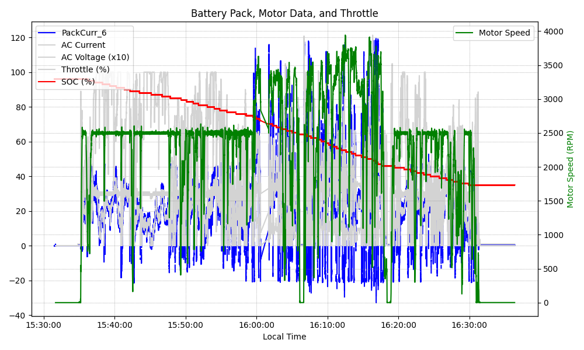
Graph Analysis

