Slide 1
Analysis Results from Folder - B3_B04_17.38_19.29

Slide 2
Analysis Results:
Metric | Value
Date and Time | 2024-03-12 17:38:19.949000 to 2024-03-12 19:29:39.538000
Total time taken for the ride | 0 days 01:51:05.326000
Actual Ampere-hours (Ah) | 31.127703055555557
Actual Watt-hours (Wh) | 1615.3908562836111
Starting SoC (Ah) | 5.944
Ending SoC (Ah) | 6.418
Starting SoC (%) | 100.0
Ending SoC (%) | 15.0
Total distance covered (km) | 57.7466072884102
Total energy consumption(WH/KM) | 27.973779450205406
Total SOC consumed(%) | 85.0
Mode | Eco mode 85.95% Sports mode 13.67%
Peak Power(kW) | 4429.9909450000005

Slide 3
Analysis Results:
Metric | Value
Average Power(kW) | -877.0030285961393
Total Energy Regenerated(kWh) | 68.13299414972222
Regenerative Effectiveness(%) | 4.047046564394381
Highest Cell Voltage(V) | 3.483
Lowest Cell Voltage(V) | 3.144
Difference in Cell Voltage(V) | 0.33899999999999997
Minimum Temperature(C) | 36.0
Maximum Temperature(C) | 48.0
Difference in Temperature(C) | 12.0
Maximum Fet Temperature-BMS(C) | 58.0
Maximum Afe Temperature-BMS(C) | 63.0
Maximum PCB Temperature-BMS(C) | 59.0
Maximum MCU Temperature(C) | 43.0

Slide 4
Analysis Results:
Metric | Value
Maximum Motor Temperature(C) | 0.0
Abnormal Motor Temperature Detected(C) | False
highest cell temp(C) | 48.0
lowest cell temp(C) | 36.0
Difference between Highest and Lowest Cell Temperature at 100% SOC(C) | 12.0
Battery Voltage(V) | 56.0
Total energy charged(kWh) | 1.743151371111111
Electricity consumption units(kW) | 7.264946949700389e-08
Cycle Count of battery | 138.0
Idling time percentage | 7.10488322717622
Time spent in 0-10 km/h | 5.470912951167728
Time spent in 10-20 km/h | 8.798301486199575
Time spent in 20-30 km/h | 14.21656050955414

Slide 5
Analysis Results:
Metric | Value
Time spent in 30-40 km/h | 41.97537154989384
Time spent in 40-50 km/h | 21.117622080679403
Time spent in 50-60 km/h | 0.0
Time spent in 60-70 km/h | 0.0
Time spent in 70-80 km/h | 0.0
Time spent in 80-90 km/h | 0.0

Slide 6
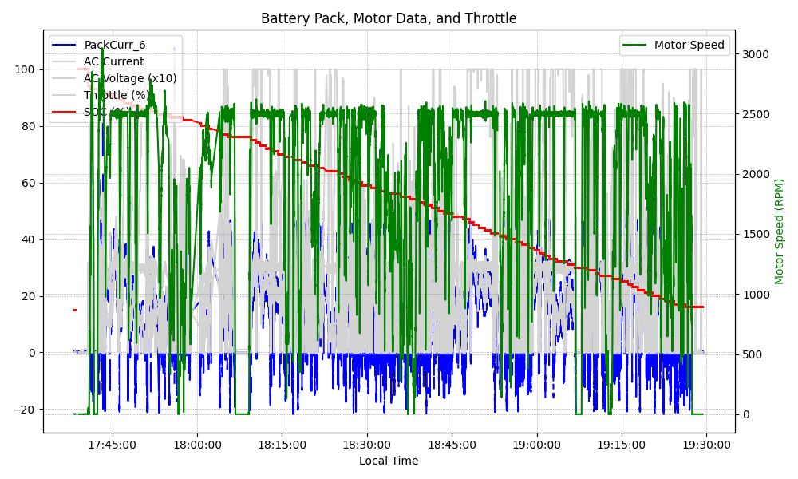
Graph Analysis

