Slide 1
Analysis Results from Folder - B3_B05_20.41_21.37

Slide 2
Analysis Results:
Metric | Value
Date and Time | 2024-03-12 20:41:47.242000 to 2024-03-12 21:37:26.915000
Total time taken for the ride | 0 days 00:55:20.893000
Actual Ampere-hours (Ah) | 31.595891666666663
Actual Watt-hours (Wh) | 1613.4894348891664
Starting SoC (Ah) | 39.532
Ending SoC (Ah) | 12.329
Starting SoC (%) | 99.0
Ending SoC (%) | 31.0
Total distance covered (km) | 32.71985919962416
Total energy consumption(WH/KM) | 49.31223649360019
Total SOC consumed(%) | 68.0
Mode | Custom mode 85.53% Eco mode 4.29% Sports mode 0.22%
Peak Power(kW) | 6138.107433

Slide 3
Analysis Results:
Metric | Value
Average Power(kW) | -1756.9757911678762
Total Energy Regenerated(kWh) | 72.2175989013889
Regenerative Effectiveness(%) | 4.284113280289114
Highest Cell Voltage(V) | 3.454
Lowest Cell Voltage(V) | 3.062
Difference in Cell Voltage(V) | 0.39200000000000035
Minimum Temperature(C) | 34.0
Maximum Temperature(C) | 44.0
Difference in Temperature(C) | 10.0
Maximum Fet Temperature-BMS(C) | 70.0
Maximum Afe Temperature-BMS(C) | 63.0
Maximum PCB Temperature-BMS(C) | 61.0
Maximum MCU Temperature(C) | 48.0

Slide 4
Analysis Results:
Metric | Value
Maximum Motor Temperature(C) | 0.0
Abnormal Motor Temperature Detected(C) | True
highest cell temp(C) | 44.0
lowest cell temp(C) | -1.0
Difference between Highest and Lowest Cell Temperature at 100% SOC(C) | 45.0
Battery Voltage(V) | 55.0
Total energy charged(kWh) | 1.7377740416666665
Electricity consumption units(kW) | 1.4539608782351628e-07
Cycle Count of battery | 42.0
Idling time percentage | 17.615442846328538
Time spent in 0-10 km/h | 9.367903103709311
Time spent in 10-20 km/h | 3.917486752460257
Time spent in 20-30 km/h | 8.096139288417865

Slide 5
Analysis Results:
Metric | Value
Time spent in 30-40 km/h | 11.654049962149886
Time spent in 40-50 km/h | 16.279333838001513
Time spent in 50-60 km/h | 15.961392884178652
Time spent in 60-70 km/h | 16.063588190764573
Time spent in 70-80 km/h | 0.9348978046934141
Time spent in 80-90 km/h | 0.0

Slide 6
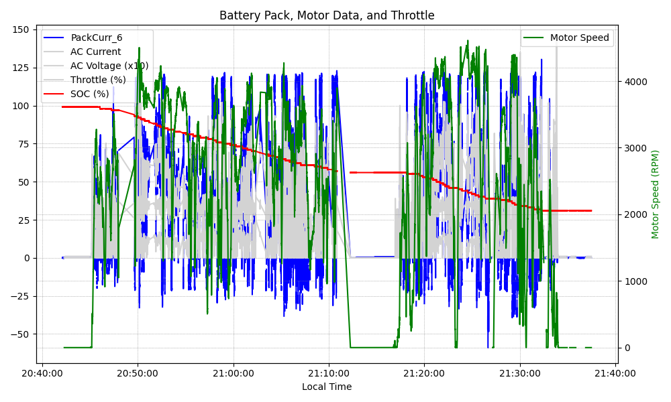
Graph Analysis

