Slide 1
Analysis Results from Folder - B4_B02_06.55_07.43

Slide 2
Analysis Results:
Metric | Value
Total time taken for the ride | 0 days 00:47:24.599000
Actual Ampere-hours (Ah) | 27.709410833333333
Actual Watt-hours (Wh) | 1390.2002717922223
Starting SoC (Ah) | 39.497
Ending SoC (Ah) | 10.219
Starting SoC (%) | 25.0
Ending SoC (%) | 99.0
Total distance covered (in kilometers) | 28.79475029579625
WH/KM | 48.279643251331755
Total SOC consumed | 74.0
Mode | Custom mode 95.48% Eco mode 3.00%
Peak Power | 5458.56792
Average Power | -1767.8279683687745

Slide 3
Analysis Results:
Metric | Value
Total Energy Regenerated | 0.011607947777777777
Regenerative Effectiveness | -0.0008349768799234199
Lowest Cell Voltage | 2.988
Highest Cell Voltage | 3.357
Difference in Cell Voltage | 0.3690000000000002
Minimum Temperature | 24.0
Maximum Temperature | 39.0
Difference in Temperature | nan
Maximum Fet Temperature | 62.0
Maximum Afe Temperature | 59.0
Maximum PCB Temperature | 57.0
Maximum MCU Temperature | 55.0
Maximum Motor Temperature | 93.0

Slide 4
Analysis Results:
Metric | Value
Abnormal Motor Temperature Detected | False
lowest cell temp | 44.0
highest cell temp | 24.0
Difference between Highest and Lowest Cell Temperature at 100% SOC | 20.0
Maximum BMS Temperature in C | 62.0
Battery Voltage | 5.3
Total energy charged in kWh | 0.14685987741666665
Electricity consumption units in kW | 1.434402615805855e-08
Idling time percentage | 35.176824680210686
Time spent in 0-10 km/h | 38.249310258339605
Time spent in 10-20 km/h | 3.210433910208176
Time spent in 20-30 km/h | 5.09572778195803
Time spent in 30-40 km/h | 7.018643926093136

Slide 5
Analysis Results:
Metric | Value
Time spent in 40-50 km/h | 8.076247805367444
Time spent in 50-60 km/h | 7.7878103837471775
Time spent in 60-70 km/h | 12.816654125909205

Slide 6
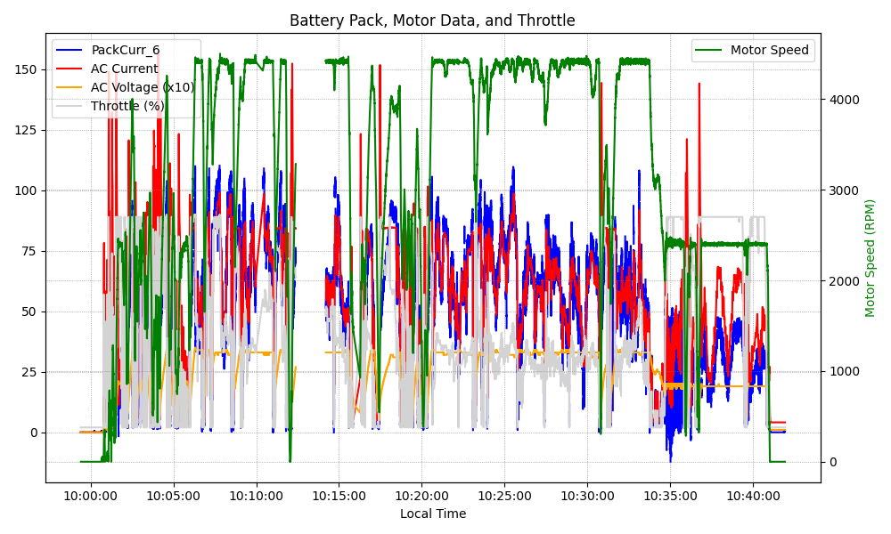
Graph Analysis

