Slide 1
Analysis Results from Folder - B4_B04_12.49_13.49

Slide 2
Analysis Results:
Metric | Value
Total time taken for the ride | 0 days 01:03:04.977000
Actual Ampere-hours (Ah) | 32.194902500000005
Actual Watt-hours (Wh) | 1649.5346833119445
Starting SoC (Ah) | 39.46
Ending SoC (Ah) | 7.847
Starting SoC (%) | 19.0
Ending SoC (%) | 99.0
Total distance covered (in kilometers) | 41.76006180344882
WH/KM | 39.50029315272026
Total SOC consumed | 80.0
Mode | Custom mode 75.45% Eco mode 14.88%
Peak Power | 4299.58034
Average Power | -1574.3173011460765

Slide 3
Analysis Results:
Metric | Value
Total Energy Regenerated | 0.2063263922222222
Regenerative Effectiveness | -0.012506592914194505
Lowest Cell Voltage | 3.095
Highest Cell Voltage | 3.46
Difference in Cell Voltage | 0.36499999999999977
Minimum Temperature | 36.0
Maximum Temperature | 45.0
Difference in Temperature | nan
Maximum Fet Temperature | 60.0
Maximum Afe Temperature | 59.0
Maximum PCB Temperature | 59.0
Maximum MCU Temperature | 52.0
Maximum Motor Temperature | 91.0

Slide 4
Analysis Results:
Metric | Value
Abnormal Motor Temperature Detected | False
lowest cell temp | 45.0
highest cell temp | 36.0
Difference between Highest and Lowest Cell Temperature at 100% SOC | 9.0
Maximum BMS Temperature in C | 60.0
Battery Voltage | 5.4
Total energy charged in kWh | 0.17385247350000002
Electricity consumption units in kW | 1.2762249933932349e-08
Idling time percentage | 16.208013540724313
Time spent in 0-10 km/h | 19.394752969329094
Time spent in 10-20 km/h | 3.323897627454986
Time spent in 20-30 km/h | 2.9737064814544607
Time spent in 30-40 km/h | 14.217760527621326

Slide 5
Analysis Results:
Metric | Value
Time spent in 40-50 km/h | 9.67403040826451
Time spent in 50-60 km/h | 42.195114833513294
Time spent in 60-70 km/h | 7.47366270756121

Slide 6
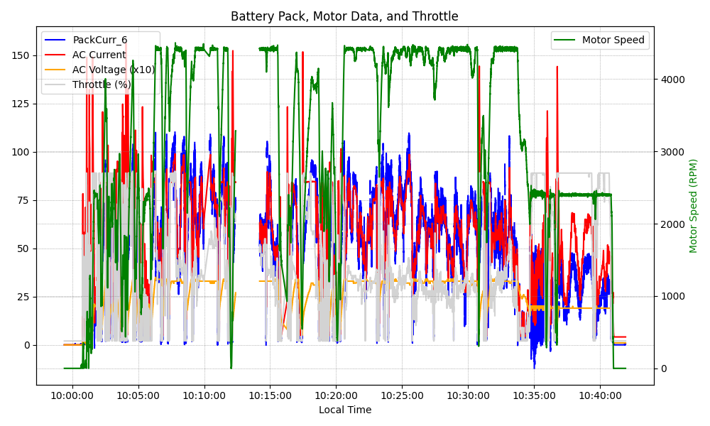
Graph Analysis

