Slide 1
Analysis Results from Folder - B4_B06_08.13_09.18

Slide 2
Analysis Results:
Metric | Value
Total time taken for the ride | 0 days 01:04:26.248000
Actual Ampere-hours (Ah) | 31.876796666666664
Actual Watt-hours (Wh) | 1597.140168137222
Starting SoC (Ah) | 35.322
Ending SoC (Ah) | 3.45
Starting SoC (%) | 8.0
Ending SoC (%) | 89.0
Total distance covered (in kilometers) | 35.2506607867321
WH/KM | 45.3080916071328
Total SOC consumed | 81.0
Mode | Custom mode 52.47% Eco mode 42.89%
Peak Power | 5429.2873850000005
Average Power | -1497.3189076286458

Slide 3
Analysis Results:
Metric | Value
Total Energy Regenerated | 0.60077226
Regenerative Effectiveness | -0.0376013560653105
Lowest Cell Voltage | 2.98
Highest Cell Voltage | 3.371
Difference in Cell Voltage | 0.391
Minimum Temperature | 26.0
Maximum Temperature | 39.0
Difference in Temperature | nan
Maximum Fet Temperature | 63.0
Maximum Afe Temperature | 58.0
Maximum PCB Temperature | 59.0
Maximum MCU Temperature | 54.0
Maximum Motor Temperature | 89.0

Slide 4
Analysis Results:
Metric | Value
Abnormal Motor Temperature Detected | False
lowest cell temp | 39.0
highest cell temp | 26.0
Difference between Highest and Lowest Cell Temperature at 100% SOC | 13.0
Maximum BMS Temperature in C | 63.0
Battery Voltage | 5.3
Total energy charged in kWh | 0.1689470223333333
Electricity consumption units in kW | 1.213909167768389e-08
Idling time percentage | 9.257095158597663
Time spent in 0-10 km/h | 12.156371730662215
Time spent in 10-20 km/h | 4.785754034501948
Time spent in 20-30 km/h | 9.323873121869783
Time spent in 30-40 km/h | 30.308848080133554

Slide 5
Analysis Results:
Metric | Value
Time spent in 40-50 km/h | 5.784641068447413
Time spent in 50-60 km/h | 8.597662771285476
Time spent in 60-70 km/h | 11.505286588759041

Slide 6
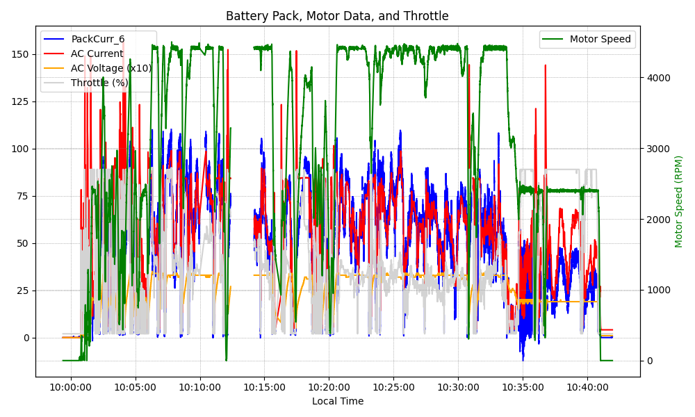
Graph Analysis

