Slide 1
Analysis Results from Folder - MAR_21

Slide 2
Analysis Results:
Metric | Value
Total time taken for the ride | 0 days 00:04:55.880000
Actual Ampere-hours (Ah) | 2.4692266666666667
Actual Watt-hours (Wh) | 125.559082875
Starting SoC (Ah) | 10.666
Ending SoC (Ah) | 13.151
Total distance covered (in kilometers) | 3.4955890920449577
WH/KM | 35.919291303643064
Total SOC consumed | 7.0
Mode | ['Sports mode: 100.00%']
Peak Power | 5136.355801
Average Power | -1537.4581576530613
Total Energy Regenerated | 0.23065293388888888
Regenerative Effectiveness | -0.18336387496617182

Slide 3
Analysis Results:
Metric | Value
Lowest Cell Voltage | 3.071
Highest Cell Voltage | 3.249
Difference in Cell Voltage | 0.17799999999999994
Minimum Temperature | 38.0
Maximum Temperature | 43.0
Difference in Temperature | 5.0
Maximum Fet Temperature | 61.0
Maximum Afe Temperature | 60.0
Maximum PCB Temperature | 60.0
Maximum MCU Temperature | 40.0
Maximum Motor Temperature | 0.0
Abnormal Motor Temperature Detected | False
Idling time percentage | 0.0

Slide 4
Analysis Results:
Metric | Value
Time spent in 0-10 km/h | 0.0
Time spent in 10-20 km/h | 0.0
Time spent in 20-30 km/h | 14.451261077027949
Time spent in 30-40 km/h | 4.567143830947512
Time spent in 40-50 km/h | 2.0790729379686437
Time spent in 50-60 km/h | 75.59645535105658
Time spent in 60-70 km/h | 3.306066802999318

Slide 5
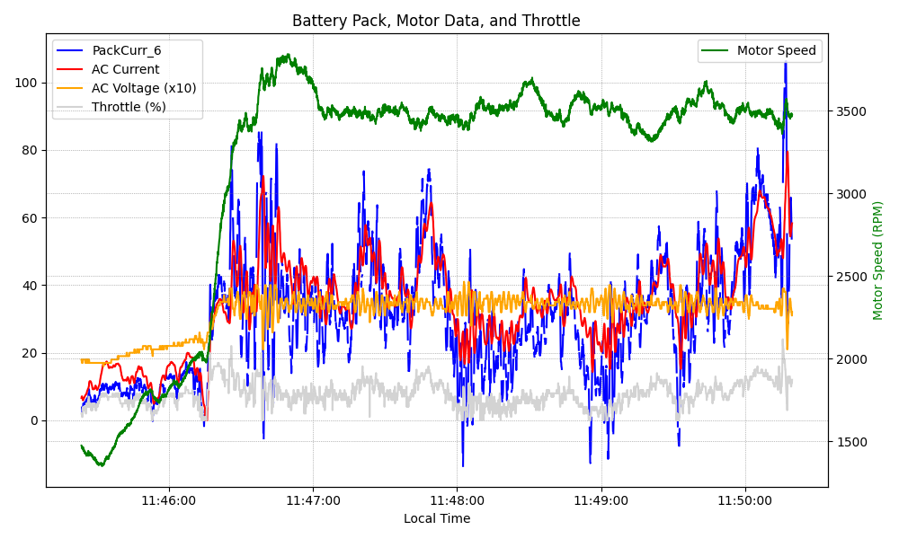
Graph Analysis

