Slide 1
Analysis Results from Folder - Battery_1

Slide 2
Analysis Results:
Metric | Value
Date and Time | 14/03/2024 14:28:12 to 14/03/2024 16:49:59
Byte Beam ID | 3
Total time taken for the ride | 0 days 02:21:47.679000
Actual Ampere-hours (Ah) | 36.233585833333336
Actual Watt-hours (Wh)- Calculated_UsingFormala | 1873.8907454497225
Starting SoC (Ah) | 3.304
Ending SoC (Ah) | 39.553
Starting SoC (%) | 99.0
Ending SoC (%) | 8.0
Total distance covered (km) | 66.38970759048718
Total energy consumption(WH/KM) | 28.22562131179243
Total SOC consumed(%) | 91.0
Mode | Eco mode 99.60%

Slide 3
Analysis Results:
Metric | Value
Peak Power(kW) | 2619.571524
Average Power(kW) | 797.3060729959817
Total Energy Regenerated(kWh) | 101.25616235277778
Regenerative Effectiveness(%) | 5.1265129673535474
Highest Cell Voltage(V) | 3.463
Lowest Cell Voltage(V) | 3.1
Difference in Cell Voltage(V) | 0.363
Minimum Temperature(C) | 37.0
Maximum Temperature(C) | 44.0
Difference in Temperature(C) | 7.0
Maximum Fet Temperature-BMS(C) | 50.0
Maximum Afe Temperature-BMS(C) | 53.0
Maximum PCB Temperature-BMS(C) | 50.0

Slide 4
Analysis Results:
Metric | Value
Maximum MCU Temperature(C) | 43.0
Maximum Motor Temperature(C) | 0.0
Abnormal Motor Temperature Detected(C) | False
highest cell temp(C) | 44.0
lowest cell temp(C) | 37.0
Difference between Highest and Lowest Cell Temperature at 100% SOC(C) | 7.0
Battery Voltage(V) | 56.0
Total energy charged(kWh)- Calculated_BatteryData | 2.029080806666667
Electricity consumption units(kW) | 6.625526712206505e-08
Cycle Count of battery | 45.0
Idling time percentage | 16.610755573905863
Time spent in 0-10 km/h | 7.879593311312965
Time spent in 10-20 km/h | 4.386870355078448

Slide 5
Analysis Results:
Metric | Value
Time spent in 20-30 km/h | 8.754386870355079
Time spent in 30-40 km/h | 42.81456440957886
Time spent in 40-50 km/h | 17.983587943848057
Time spent in 50-60 km/h | 0.0
Time spent in 60-70 km/h | 0.0
Time spent in 70-80 km/h | 0.0
Time spent in 80-90 km/h | 0.0

Slide 6
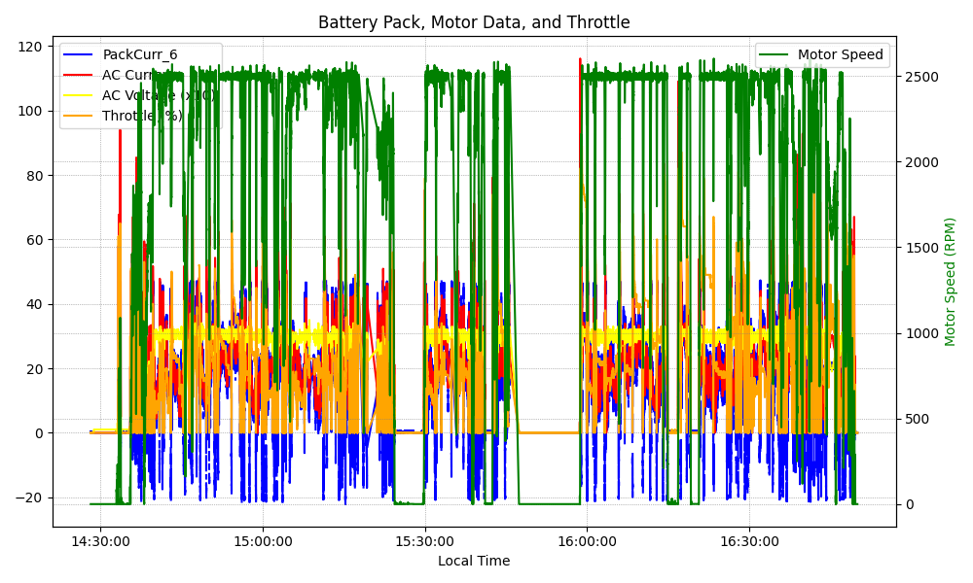
Graph Analysis

