Slide 1
Analysis Results from Folder - Battery_2

Slide 2
Analysis Results:
Metric | Value
Date and Time | 13/03/2024 10:10:57 to 13/03/2024 12:21:59
Byte Beam ID | 3
Total time taken for the ride | 0 days 02:11:02.469000
Actual Ampere-hours (Ah) | 31.82047111111111
Actual Watt-hours (Wh)- Calculated_UsingFormala | 1641.0164183574998
Starting SoC (Ah) | 5.591
Ending SoC (Ah) | 38.593
Starting SoC (%) | 97.0
Ending SoC (%) | 14.0
Total distance covered (km) | 61.48882354509939
Total energy consumption(WH/KM) | 26.68804383863167
Total SOC consumed(%) | 83.0
Mode | Eco mode 95.57%

Slide 3
Analysis Results:
Metric | Value
Peak Power(kW) | 2474.4841380000003
Average Power(kW) | 755.7450564266342
Total Energy Regenerated(kWh) | 151.27600766444442
Regenerative Effectiveness(%) | 8.440364165361498
Highest Cell Voltage(V) | 3.338
Lowest Cell Voltage(V) | 3.114
Difference in Cell Voltage(V) | 0.2240000000000002
Minimum Temperature(C) | 27.0
Maximum Temperature(C) | 38.0
Difference in Temperature(C) | 11.0
Maximum Fet Temperature-BMS(C) | 43.0
Maximum Afe Temperature-BMS(C) | 47.0
Maximum PCB Temperature-BMS(C) | 44.0

Slide 4
Analysis Results:
Metric | Value
Maximum MCU Temperature(C) | 44.0
Maximum Motor Temperature(C) | 0.0
Abnormal Motor Temperature Detected(C) | False
highest cell temp(C) | 38.0
lowest cell temp(C) | 27.0
Difference between Highest and Lowest Cell Temperature at 100% SOC(C) | 11.0
Battery Voltage(V) | 55.0
Total energy charged(kWh)- Calculated_BatteryData | 1.750125911111111
Electricity consumption units(kW) | 6.183491305262695e-08
Cycle Count of battery | 43.0
Idling time percentage | 12.50572288738745
Time spent in 0-10 km/h | 7.189333925276433
Time spent in 10-20 km/h | 7.228180191179123

Slide 5
Analysis Results:
Metric | Value
Time spent in 20-30 km/h | 14.518791881130428
Time spent in 30-40 km/h | 43.11658041870725
Time spent in 40-50 km/h | 14.292651118911195
Time spent in 50-60 km/h | 0.0
Time spent in 60-70 km/h | 0.0
Time spent in 70-80 km/h | 0.0
Time spent in 80-90 km/h | 0.0

Slide 6
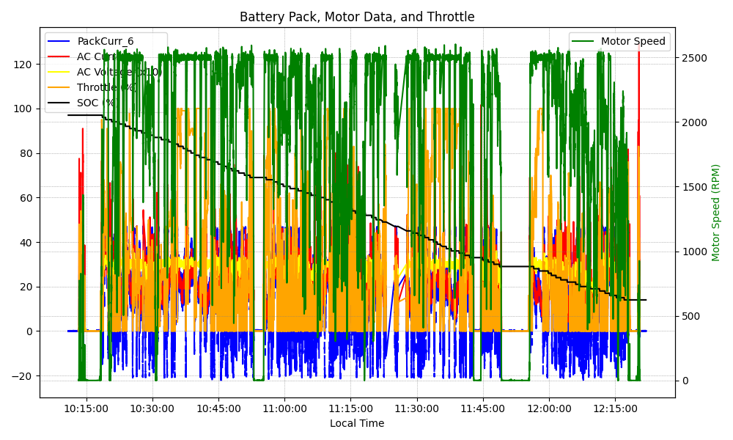
Graph Analysis

