Slide 1
Analysis Results from Folder - B4_BT02_09.56_10.40

Slide 2
Analysis Results:
Metric | Value
Total time taken for the ride | 0 days 00:44:23.041000
Actual Ampere-hours (Ah) | 29.750206944444443
Actual Watt-hours (Wh) | 1500.779628262778
Starting SoC (Ah) | 38.875
Ending SoC (Ah) | 9.035
Starting SoC (%) | 22.0
Ending SoC (%) | 98.0
Total distance covered (in kilometers) | 30.625690105268312
WH/KM | 49.00394482880926
Total SOC consumed | 76.0
Mode | Custom mode 85.04% Eco mode 13.92% Sports mode 0.04%
Peak Power | 5427.163392
Average Power | -2035.722178502638

Slide 3
Analysis Results:
Metric | Value
Total Energy Regenerated | 0.012831445277777775
Regenerative Effectiveness | -0.000854977994777095
Lowest Cell Voltage | 3.017
Highest Cell Voltage | 3.329
Difference in Cell Voltage | 0.3120000000000003
Minimum Temperature | 26.0
Maximum Temperature | 40.0
Difference in Temperature | nan
Maximum Fet Temperature | 62.0
Maximum Afe Temperature | 60.0
Maximum PCB Temperature | 57.0
Maximum MCU Temperature | 66.0
Maximum Motor Temperature | 102.0

Slide 4
Analysis Results:
Metric | Value
Abnormal Motor Temperature Detected | False
lowest cell temp | 40.0
highest cell temp | 25.0
Difference between Highest and Lowest Cell Temperature at 100% SOC | 15.0
Maximum BMS Temperature in C | 62.0
Battery Voltage | 5.3
Total energy charged in kWh | 0.15767609680555555
Electricity consumption units in kW | 1.6447208328697328e-08
Idling time percentage | 6.458357991083758
Time spent in 0-10 km/h | 16.952696571586383
Time spent in 10-20 km/h | 5.3694717323549135
Time spent in 20-30 km/h | 8.675582909220026
Time spent in 30-40 km/h | 13.358582869767623

Slide 5
Analysis Results:
Metric | Value
Time spent in 40-50 km/h | 12.277587091174498
Time spent in 50-60 km/h | 12.65633013768888
Time spent in 60-70 km/h | 19.78143370024066

Slide 6
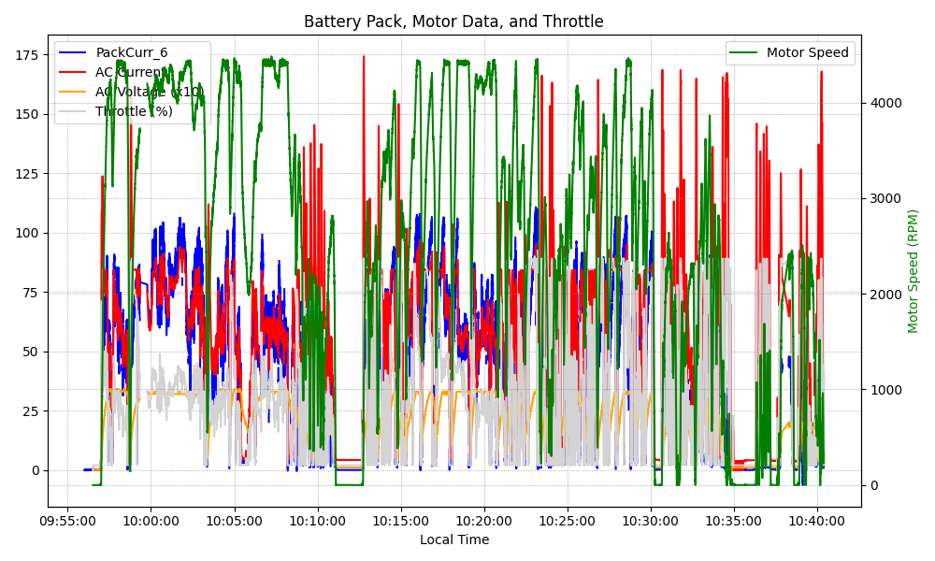
Graph Analysis

