Slide 1
Analysis Results from Folder - B4_BT06_09.00_09.55

Slide 2
Analysis Results:
Metric | Value
Total time taken for the ride | 0 days 00:50:09.776000
Actual Ampere-hours (Ah) | 27.755521666666667
Actual Watt-hours (Wh) | 1385.7406769913891
Starting SoC (Ah) | 38.746
Ending SoC (Ah) | 10.259
Starting SoC (%) | 25.0
Ending SoC (%) | 97.0
Total distance covered (in kilometers) | 27.14685761272991
WH/KM | 51.04608042521935
Total SOC consumed | 72.0
Mode | Custom mode 90.09% Eco mode 8.86% Sports mode 0.07%
Peak Power | 5724.067349
Average Power | -1668.4503134344484

Slide 3
Analysis Results:
Metric | Value
Total Energy Regenerated | 0.024432869166666666
Regenerative Effectiveness | -0.0017631320772050073
Lowest Cell Voltage | 2.963
Highest Cell Voltage | 3.326
Difference in Cell Voltage | 0.363
Minimum Temperature | 25.0
Maximum Temperature | 40.0
Difference in Temperature | nan
Maximum Fet Temperature | 70.0
Maximum Afe Temperature | 63.0
Maximum PCB Temperature | 64.0
Maximum MCU Temperature | 60.0
Maximum Motor Temperature | 95.0

Slide 4
Analysis Results:
Metric | Value
Abnormal Motor Temperature Detected | False
lowest cell temp | 40.0
highest cell temp | 25.0
Difference between Highest and Lowest Cell Temperature at 100% SOC | 15.0
Maximum BMS Temperature in C | 70.0
Battery Voltage | 5.5
Total energy charged in kWh | 0.15265536916666667
Electricity consumption units in kW | 1.409247896741873e-08
Idling time percentage | 24.73772555602182
Time spent in 0-10 km/h | 32.94167016365925
Time spent in 10-20 km/h | 6.61281298083648
Time spent in 20-30 km/h | 7.522031053294167
Time spent in 30-40 km/h | 8.375297244369841

Slide 5
Analysis Results:
Metric | Value
Time spent in 40-50 km/h | 11.655476290390263
Time spent in 50-60 km/h | 8.120016785564415
Time spent in 60-70 km/h | 12.764022940271365

Slide 6
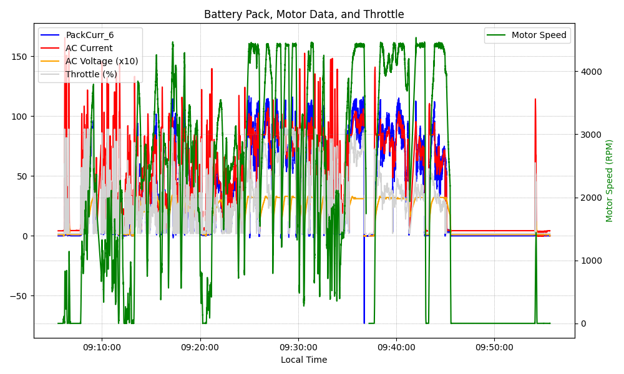
Graph Analysis

