Slide 1
Analysis Results from Folder - B4_BT03_14.54_15.49

Slide 2
Analysis Results:
Metric | Value
Total time taken for the ride | 0 days 00:54:10.980000
Actual Ampere-hours (Ah) | 33.50618638888889
Actual Watt-hours (Wh) | 1709.0979718525
Starting SoC (Ah) | 37.269
Ending SoC (Ah) | 3.638
Starting SoC (%) | 9.0
Ending SoC (%) | 94.0
Total distance covered (in kilometers) | 37.58353708281574
WH/KM | 45.47464407318778
Total SOC consumed | 85.0
Mode | Custom mode 67.79% Eco mode 32.21%
Peak Power | 4552.1056
Average Power | -1900.75770734291

Slide 3
Analysis Results:
Metric | Value
Total Energy Regenerated | 2.3885110119444444
Regenerative Effectiveness | -0.13955769068925933
Lowest Cell Voltage | 3.047
Highest Cell Voltage | 3.349
Difference in Cell Voltage | 0.30200000000000005
Minimum Temperature | 37.0
Maximum Temperature | 47.0
Difference in Temperature | nan
Maximum Fet Temperature | 70.0
Maximum Afe Temperature | 67.0
Maximum PCB Temperature | 65.0
Maximum MCU Temperature | 68.0
Maximum Motor Temperature | 100.0

Slide 4
Analysis Results:
Metric | Value
Abnormal Motor Temperature Detected | False
lowest cell temp | 47.0
highest cell temp | 37.0
Difference between Highest and Lowest Cell Temperature at 100% SOC | 10.0
Maximum BMS Temperature in C | 70.0
Battery Voltage | 5.3
Total energy charged in kWh | 0.17758278786111112
Electricity consumption units in kW | 1.5178016056505224e-08
Idling time percentage | 0.8162224206096161
Time spent in 0-10 km/h | 3.6092335161331466
Time spent in 10-20 km/h | 3.7527101135059304
Time spent in 20-30 km/h | 12.431450070144114
Time spent in 30-40 km/h | 37.881010075245506

Slide 5
Analysis Results:
Metric | Value
Time spent in 40-50 km/h | 13.16158653233006
Time spent in 50-60 km/h | 17.50095651064915
Time spent in 60-70 km/h | 9.233516133146283

Slide 6
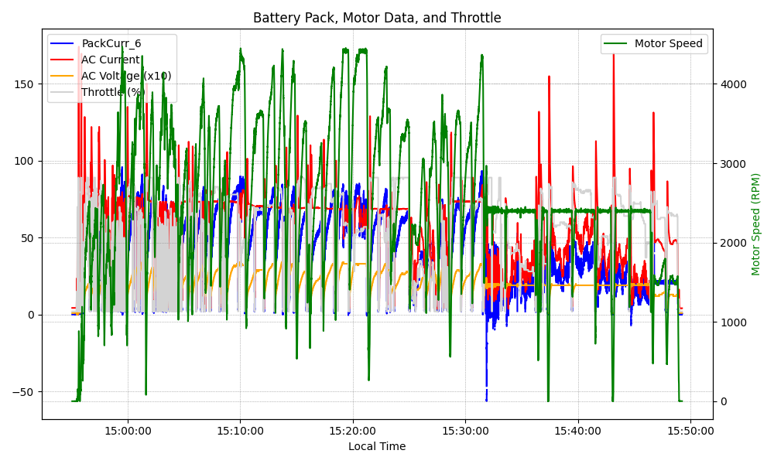
Graph Analysis

