Slide 1
Analysis Results from Folder - B4_BT04_10.45_11.45

Slide 2
Analysis Results:
Metric | Value
Total time taken for the ride | 0 days 00:48:52.009000
Actual Ampere-hours (Ah) | 28.380030555555553
Actual Watt-hours (Wh) | 1430.0007831291666
Starting SoC (Ah) | 38.841
Ending SoC (Ah) | 10.178
Starting SoC (%) | 25.0
Ending SoC (%) | 98.0
Total distance covered (in kilometers) | 31.969494056241714
WH/KM | 44.73016622075612
Total SOC consumed | 73.0
Mode | Custom mode 97.11% Eco mode 1.34% Sports mode 0.08%
Peak Power | 5437.23852
Average Power | -1767.8581110113323

Slide 3
Analysis Results:
Metric | Value
Total Energy Regenerated | 0.045046905
Regenerative Effectiveness | -0.003150032261478203
Lowest Cell Voltage | 3.0
Highest Cell Voltage | 3.326
Difference in Cell Voltage | 0.32600000000000007
Minimum Temperature | 27.0
Maximum Temperature | 41.0
Difference in Temperature | nan
Maximum Fet Temperature | 67.0
Maximum Afe Temperature | 60.0
Maximum PCB Temperature | 59.0
Maximum MCU Temperature | 59.0
Maximum Motor Temperature | 97.0

Slide 4
Analysis Results:
Metric | Value
Abnormal Motor Temperature Detected | False
lowest cell temp | 41.0
highest cell temp | 27.0
Difference between Highest and Lowest Cell Temperature at 100% SOC | 14.0
Maximum BMS Temperature in C | 67.0
Battery Voltage | 5.3
Total energy charged in kWh | 0.15041416194444443
Electricity consumption units in kW | 1.4250242718702102e-08
Idling time percentage | 0.555415299166877
Time spent in 0-10 km/h | 4.208893857972374
Time spent in 10-20 km/h | 5.106935478053883
Time spent in 20-30 km/h | 10.891910412233564
Time spent in 30-40 km/h | 10.578136834132795

Slide 5
Analysis Results:
Metric | Value
Time spent in 40-50 km/h | 7.844339452519206
Time spent in 50-60 km/h | 10.09845998485231
Time spent in 60-70 km/h | 13.311934215746385

Slide 6
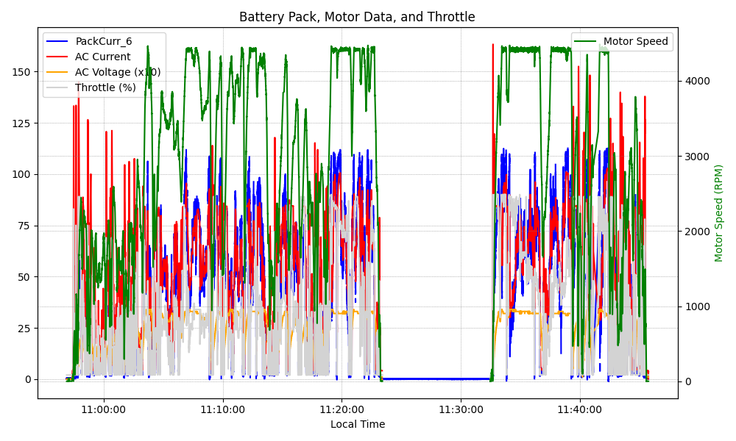
Graph Analysis

