Slide 1
Analysis Results from Folder - B4_BT06_13.03_13.56

Slide 2
Analysis Results:
Metric | Value
Total time taken for the ride | 0 days 00:50:13.716000
Actual Ampere-hours (Ah) | 27.04170027777778
Actual Watt-hours (Wh) | 1368.2177338797221
Starting SoC (Ah) | 37.854
Ending SoC (Ah) | 10.0
Starting SoC (%) | 25.0
Ending SoC (%) | 95.0
Total distance covered (in kilometers) | 26.02395091125489
WH/KM | 52.575327187848046
Total SOC consumed | 70.0
Mode | Custom mode 71.62% Eco mode 8.79% Sports mode 0.07%
Peak Power | 5454.527923
Average Power | -1637.4946283134973

Slide 3
Analysis Results:
Metric | Value
Total Energy Regenerated | 0.6062592772222223
Regenerative Effectiveness | -0.044290520932789554
Lowest Cell Voltage | 3.0
Highest Cell Voltage | 3.345
Difference in Cell Voltage | 0.3450000000000002
Minimum Temperature | 37.0
Maximum Temperature | 47.0
Difference in Temperature | nan
Maximum Fet Temperature | 70.0
Maximum Afe Temperature | 65.0
Maximum PCB Temperature | 66.0
Maximum MCU Temperature | 68.0
Maximum Motor Temperature | 99.0

Slide 4
Analysis Results:
Metric | Value
Abnormal Motor Temperature Detected | False
lowest cell temp | 47.0
highest cell temp | 37.0
Difference between Highest and Lowest Cell Temperature at 100% SOC | 10.0
Maximum BMS Temperature in C | 70.0
Battery Voltage | 5.3
Total energy charged in kWh | 0.14332101147222223
Electricity consumption units in kW | 1.3213206795757479e-08
Idling time percentage | 23.570573945832276
Time spent in 0-10 km/h | 35.470069975707915
Time spent in 10-20 km/h | 5.337007360139226
Time spent in 20-30 km/h | 6.834414995830464
Time spent in 30-40 km/h | 10.674014720278452

Slide 5
Analysis Results:
Metric | Value
Time spent in 40-50 km/h | 11.04020883941844
Time spent in 50-60 km/h | 13.41503208730648
Time spent in 60-70 km/h | 15.394655741271166

Slide 6
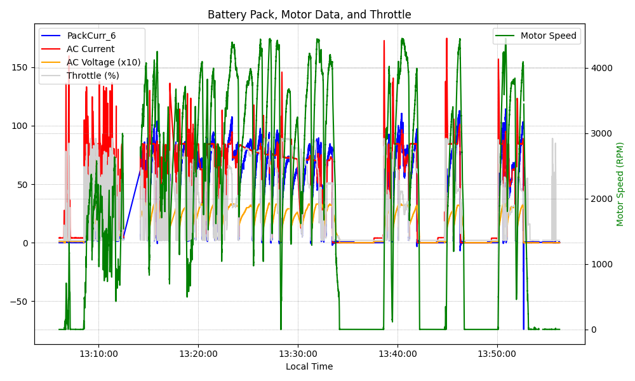
Graph Analysis

