Slide 1
Analysis Results from Folder - B4_BT06_17.05_17.45

Slide 2
Analysis Results:
Metric | Value
Total time taken for the ride | 0 days 00:39:56.273000
Actual Ampere-hours (Ah) | 20.897132222222226
Actual Watt-hours (Wh) | 1058.0849816355556
Starting SoC (Ah) | 25.2
Ending SoC (Ah) | 3.427
Starting SoC (%) | 8.0
Ending SoC (%) | 63.0
Total distance covered (in kilometers) | 24.58373603844754
WH/KM | 43.040039967105564
Total SOC consumed | 55.0
Mode | Custom mode 56.98% Eco mode 43.02%
Peak Power | 5176.618119
Average Power | -1595.1029873902849

Slide 3
Analysis Results:
Metric | Value
Total Energy Regenerated | 0.061052225
Regenerative Effectiveness | -0.005769735277205185
Lowest Cell Voltage | 3.034
Highest Cell Voltage | 3.338
Difference in Cell Voltage | 0.30400000000000027
Minimum Temperature | 40.0
Maximum Temperature | 47.0
Difference in Temperature | nan
Maximum Fet Temperature | 66.0
Maximum Afe Temperature | 61.0
Maximum PCB Temperature | 62.0
Maximum MCU Temperature | 68.0
Maximum Motor Temperature | 98.0

Slide 4
Analysis Results:
Metric | Value
Abnormal Motor Temperature Detected | False
lowest cell temp | 47.0
highest cell temp | 40.0
Difference between Highest and Lowest Cell Temperature at 100% SOC | 7.0
Maximum BMS Temperature in C | 66.0
Battery Voltage | 5.3
Total energy charged in kWh | 0.11075480077777779
Electricity consumption units in kW | 1.2840243087759435e-08
Idling time percentage | 1.3204389064534128
Time spent in 0-10 km/h | 6.18374558303887
Time spent in 10-20 km/h | 6.578947368421052
Time spent in 20-30 km/h | 12.702250325460293
Time spent in 30-40 km/h | 51.9434628975265

Slide 5
Analysis Results:
Metric | Value
Time spent in 40-50 km/h | 9.852148037939372
Time spent in 50-60 km/h | 7.374000371954621
Time spent in 60-70 km/h | 4.389064534126836

Slide 6
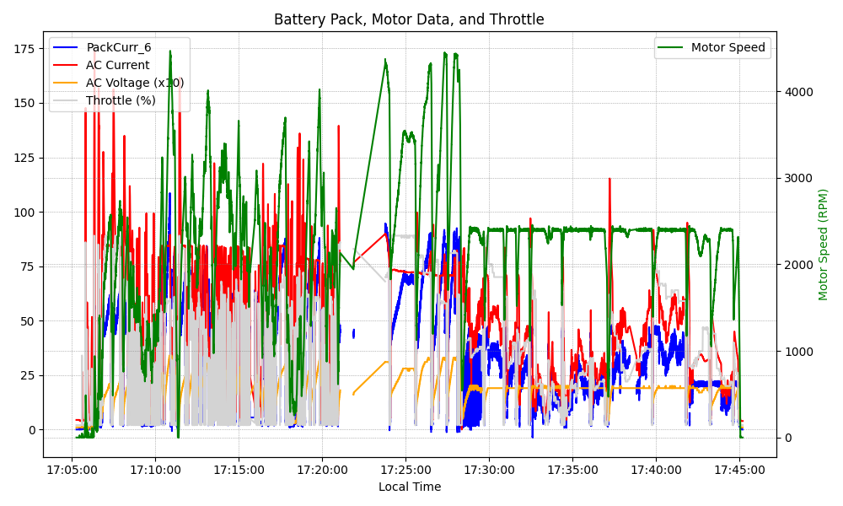
Graph Analysis

