Slide 1
Analysis Results from Folder - B4_B02_09.59_10.41

Slide 2
Analysis Results:
Metric | Value
Total time taken for the ride | 0 days 00:42:32.618000
Actual Ampere-hours (Ah) | 32.19162166666667
Actual Watt-hours (Wh) | 1632.661795212778
Starting SoC (Ah) | 39.551
Ending SoC (Ah) | 7.43
Starting SoC (%) | 18.0
Ending SoC (%) | 99.0
Total distance covered (in kilometers) | 35.8652854330722
WH/KM | 45.5220633405935
Total SOC consumed | 81.0
Mode | Custom mode 76.57% Eco mode 19.91% Sports mode 0.31%
Peak Power | 5490.365296
Average Power | -2312.1882229606613

Slide 3
Analysis Results:
Metric | Value
Total Energy Regenerated | 0.4675920697222222
Regenerative Effectiveness | -0.028631660991679762
Lowest Cell Voltage | 3.039
Highest Cell Voltage | 3.443
Difference in Cell Voltage | 0.4039999999999999
Minimum Temperature | 35.0
Maximum Temperature | 47.0
Difference in Temperature | nan
Maximum Fet Temperature | 70.0
Maximum Afe Temperature | 68.0
Maximum PCB Temperature | 66.0
Maximum MCU Temperature | 56.0
Maximum Motor Temperature | 97.0

Slide 4
Analysis Results:
Metric | Value
Abnormal Motor Temperature Detected | False
lowest cell temp | 47.0
highest cell temp | 35.0
Difference between Highest and Lowest Cell Temperature at 100% SOC | 12.0
Maximum BMS Temperature in C | 70.0
Battery Voltage | 5.4
Total energy charged in kWh | 0.17383475700000003
Electricity consumption units in kW | 1.892140771943574e-08
Idling time percentage | 5.573094799614137
Time spent in 0-10 km/h | 8.756467596246601
Time spent in 10-20 km/h | 3.2886082609839518
Time spent in 20-30 km/h | 4.9416820135052175
Time spent in 30-40 km/h | 24.248004910988335

Slide 5
Analysis Results:
Metric | Value
Time spent in 40-50 km/h | 6.590370955011839
Time spent in 50-60 km/h | 5.39331754801368
Time spent in 60-70 km/h | 18.23642900990967

Slide 6
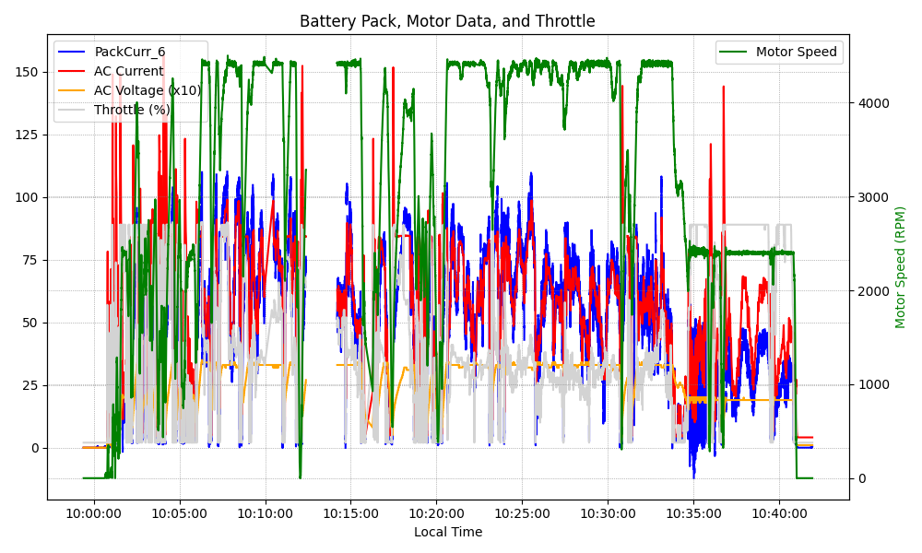
Graph Analysis

