Slide 1
Analysis Results from Folder - B4_B02_16.59_18.03

Slide 2
Analysis Results:
Metric | Value
Total time taken for the ride | 0 days 01:03:45.240000
Actual Ampere-hours (Ah) | 27.283976111111112
Actual Watt-hours (Wh) | 1403.2693823775
Starting SoC (Ah) | 39.512
Ending SoC (Ah) | 12.605
Starting SoC (%) | 31.0
Ending SoC (%) | 99.0
Total distance covered (in kilometers) | 30.988486215027667
WH/KM | 45.283573151662814
Total SOC consumed | 68.0
Mode | Custom mode 97.62% Eco mode 0.11%
Peak Power | 4861.082784
Average Power | -1326.6202144325105

Slide 3
Analysis Results:
Metric | Value
Total Energy Regenerated | 0.010689247222222222
Regenerative Effectiveness | -0.0007617329881871818
Lowest Cell Voltage | 3.095
Highest Cell Voltage | 3.436
Difference in Cell Voltage | 0.34099999999999975
Minimum Temperature | 38.0
Maximum Temperature | 44.0
Difference in Temperature | nan
Maximum Fet Temperature | 58.0
Maximum Afe Temperature | 59.0
Maximum PCB Temperature | 56.0
Maximum MCU Temperature | 54.0
Maximum Motor Temperature | 94.0

Slide 4
Analysis Results:
Metric | Value
Abnormal Motor Temperature Detected | False
lowest cell temp | 44.0
highest cell temp | 38.0
Difference between Highest and Lowest Cell Temperature at 100% SOC | 6.0
Maximum BMS Temperature in C | 58.0
Battery Voltage | 5.4
Total energy charged in kWh | 0.147333471
Electricity consumption units in kW | 1.0699598474945532e-08
Idling time percentage | 1.4031269686730428
Time spent in 0-10 km/h | 25.602771891644238
Time spent in 10-20 km/h | 7.490979898058531
Time spent in 20-30 km/h | 11.459824752305137
Time spent in 30-40 km/h | 14.729969646641086

Slide 5
Analysis Results:
Metric | Value
Time spent in 40-50 km/h | 20.29379760609358
Time spent in 50-60 km/h | 16.4165855334746
Time spent in 60-70 km/h | 2.906477292251303

Slide 6
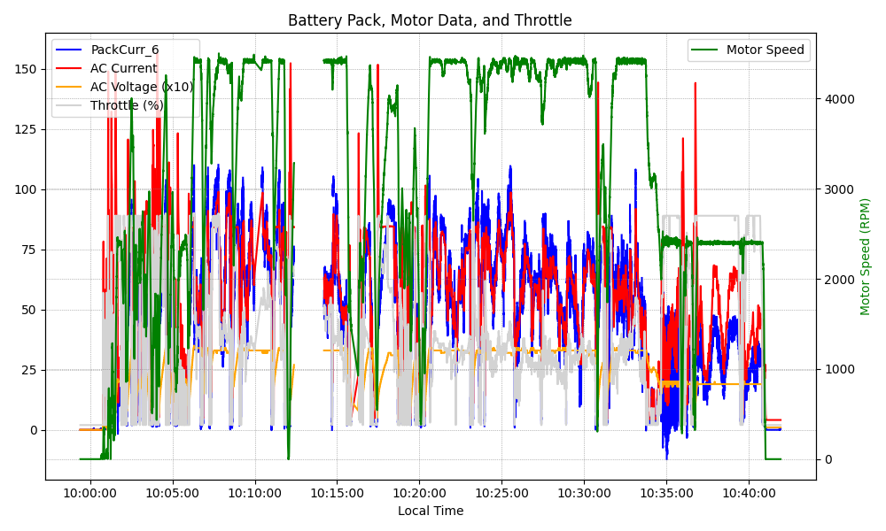
Graph Analysis

