Slide 1
Analysis Results from Folder - B4_B03_10.41_11.48

Slide 2
Analysis Results:
Metric | Value
Total time taken for the ride | 0 days 01:06:30.855000
Actual Ampere-hours (Ah) | 32.33816583333333
Actual Watt-hours (Wh) | 1642.2231010166665
Starting SoC (Ah) | 7.43
Ending SoC (Ah) | 7.051
Starting SoC (%) | 17.0
Ending SoC (%) | 99.0
Total distance covered (in kilometers) | 36.218297428121346
WH/KM | 45.34236056445818
Total SOC consumed | 1.0
Mode | Custom mode 79.89% Eco mode 18.74% Sports mode 0.03%
Peak Power | 5233.3208
Average Power | -1489.9201521320563

Slide 3
Analysis Results:
Metric | Value
Total Energy Regenerated | 3.3656821438888893
Regenerative Effectiveness | -0.20452753314377137
Lowest Cell Voltage | 3.032
Highest Cell Voltage | 3.491
Difference in Cell Voltage | 0.4590000000000001
Minimum Temperature | 31.0
Maximum Temperature | 47.0
Difference in Temperature | nan
Maximum Fet Temperature | 60.0
Maximum Afe Temperature | 63.0
Maximum PCB Temperature | 60.0
Maximum MCU Temperature | 59.0
Maximum Motor Temperature | 98.0

Slide 4
Analysis Results:
Metric | Value
Abnormal Motor Temperature Detected | False
lowest cell temp | 47.0
highest cell temp | 31.0
Difference between Highest and Lowest Cell Temperature at 100% SOC | 16.0
Maximum BMS Temperature in C | 60.0
Battery Voltage | 5.4
Total energy charged in kWh | 0.1746260955
Electricity consumption units in kW | 1.2157205200501253e-08
Idling time percentage | 15.850230603389459
Time spent in 0-10 km/h | 20.95898261605218
Time spent in 10-20 km/h | 6.159430177660126
Time spent in 20-30 km/h | 9.376961493327512
Time spent in 30-40 km/h | 14.21553912070518

Slide 5
Analysis Results:
Metric | Value
Time spent in 40-50 km/h | 8.711077149796687
Time spent in 50-60 km/h | 6.555140135905903
Time spent in 60-70 km/h | 14.488442540185028

Slide 6
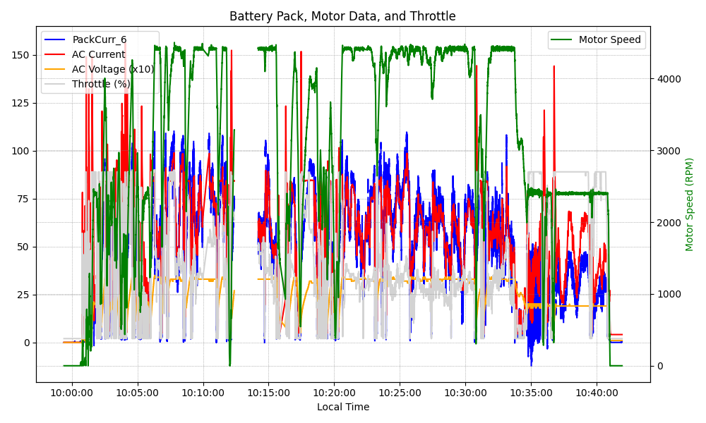
Graph Analysis

