Slide 1
Analysis Results from Folder - B4_B04_09.18_09.42

Slide 2
Analysis Results:
Metric | Value
Total time taken for the ride | 0 days 00:22:55.296000
Actual Ampere-hours (Ah) | 7.712716944444444
Actual Watt-hours (Wh) | 391.59873830777775
Starting SoC (Ah) | 12.152
Ending SoC (Ah) | 4.983
Starting SoC (%) | 12.0
Ending SoC (%) | 30.0
Total distance covered (in kilometers) | 11.775020637923902
WH/KM | 33.25673477348758
Total SOC consumed | 18.0
Mode | Eco mode 97.32%
Peak Power | 2444.592456
Average Power | -1028.2680218147336

Slide 3
Analysis Results:
Metric | Value
Total Energy Regenerated | 0.16853143916666669
Regenerative Effectiveness | -0.04301825399439998
Lowest Cell Voltage | 3.086
Highest Cell Voltage | 3.295
Difference in Cell Voltage | 0.20900000000000007
Minimum Temperature | 26.0
Maximum Temperature | 29.0
Difference in Temperature | nan
Maximum Fet Temperature | 35.0
Maximum Afe Temperature | 38.0
Maximum PCB Temperature | 37.0
Maximum MCU Temperature | 46.0
Maximum Motor Temperature | 77.0

Slide 4
Analysis Results:
Metric | Value
Abnormal Motor Temperature Detected | False
lowest cell temp | 29.0
highest cell temp | 26.0
Difference between Highest and Lowest Cell Temperature at 100% SOC | 3.0
Maximum BMS Temperature in C | 35.0
Battery Voltage | 5.2
Total energy charged in kWh | 0.04010612811111111
Electricity consumption units in kW | 8.102248103254769e-09
Idling time percentage | 3.346192552834619
Time spent in 0-10 km/h | 11.531365313653136
Time spent in 10-20 km/h | 5.191211003019121
Time spent in 20-30 km/h | 8.134854075813486
Time spent in 30-40 km/h | 73.6330090573633

Slide 5
Analysis Results:
Metric | Value
Time spent in 40-50 km/h | 0.008386447500838645
Time spent in 50-60 km/h | 0.0
Time spent in 60-70 km/h | 0.0

Slide 6
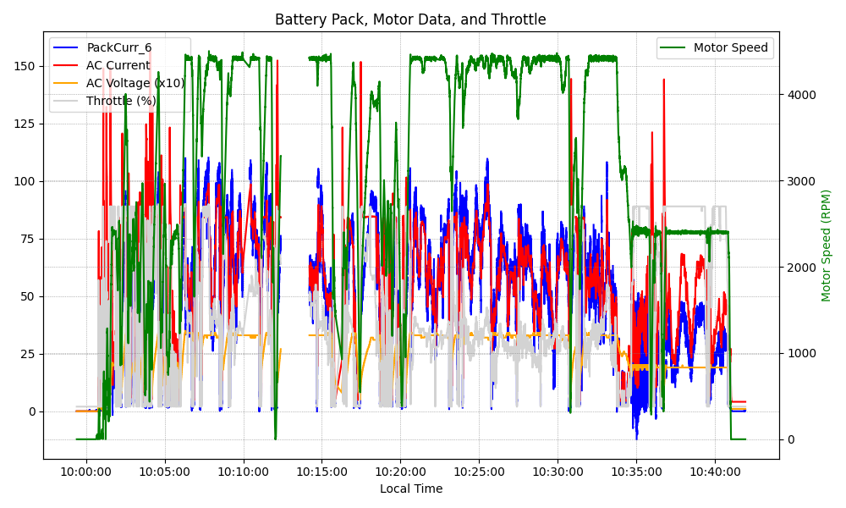
Graph Analysis

